Slide 1
DANIEL 9:24-27
REMEMBER THIS IS SPECIFIC TO THE NATION OF ISRAEL
This prophecy was given by Daniel while in exile under the Babylonian rule
to end rebellion...
to end sin…
to atone for iniquity…
to bring in everlasting righteousness …
to seal up the prophetic vision…
to anoint the most holy place…
70 WEEKS
DECREE
SECOND
COMING
70 WEEKS (shâbûa‛) OF YEARS (70 X 7 = 490)
GODS PROPHETIC CLOCK

Slide 2
GOD'S PROPHETIC CLOCK
7 WEEKS
62 WEEKS
1 WEEK
CHURCH
49
434 YEARS
7
CLOCK STARTS
CLOCK STOPS
CLOCK STARTS
CLOCK STOPS
SECOND
COMING
DECREE
70 WEEKS (490YRS)
444BC
Artaxeres
Neh 2:5-8
Rebuilding
of
Jerusalem
Cutting off of the
Messiah

Slide 3
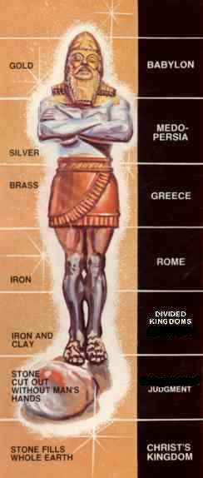
DANIEL 2
HISTORY CONFIRMS THESE KINGDOMS REIGN OVER THE REGION
DANIEL IS GIVEN UNDERSTANDING INTO HUMANITIES FUTURE AND THE KINGDOMS THAT WILL RULE OVER THE REGION
WE ARE LIVING AT THIS POINT IN HISTORY

Slide 4
CUTTING OFF
THE MESSIAH
SECOND
COMING
DECREE
69 WEEKS
1 WEEK
CHURCH
444BC Artaxeres
Neh 2:5-8

Slide 5
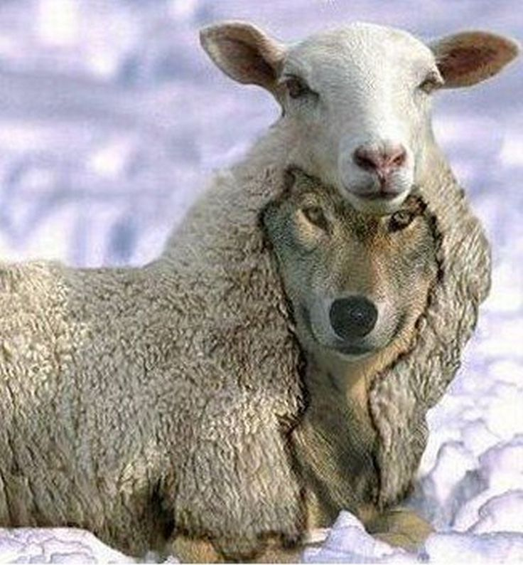
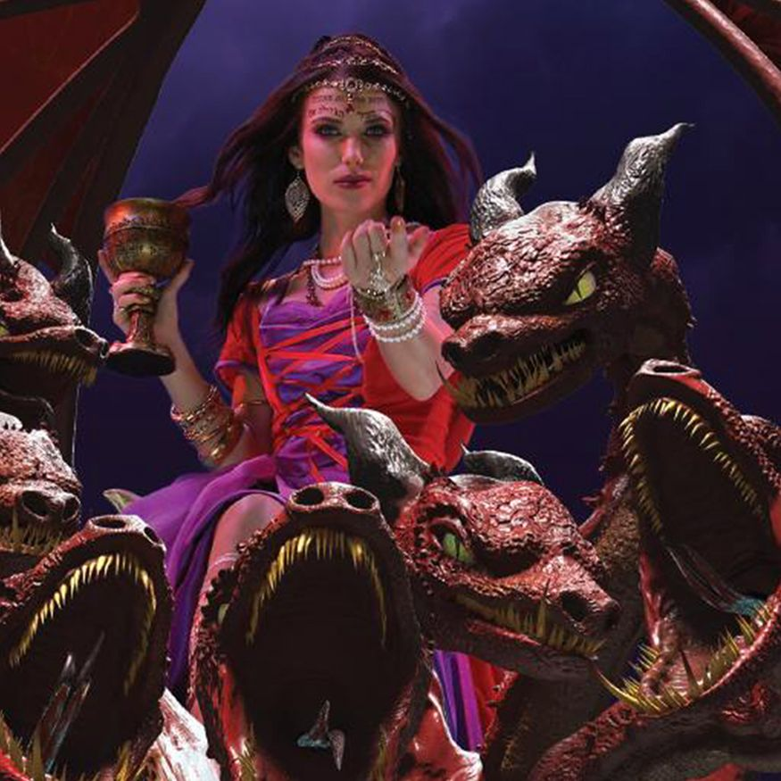

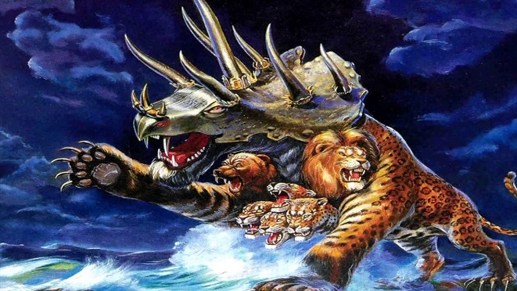
FEET AND 10 TOES
FALSE
PROPHET
THE
BEAST
THE
WOMAN
THE
ANTICHRIST

Slide 6
FALSE PROPHET
GLOBAL RELIGIOUS LEADER
2 Horns like a lamb (appears to be religious)
Speaks like a dragon (satanically inspired)
Exercises the power of the beast
Through signs and wonders he deceives the world
Makes the world worship the beast
He makes an image of the beast
He gives life to the image
People are forced to worship the image or die
Causes people to receive a mark in forehead or right hand
Cannot buy or sell without the mark or name or number
Number of the beast is 666 (the number of a man)

Slide 7
THE BEAST
GLOBAL GOVERMENT ANDTHE ANTICHRIST
7 Heads (7 kingdoms)
10 Horns and 10 Crowns (The 10 kings of the 7th kingdom)
Like a leopard, feet like a bear and a mouth like a lion
Dragon (satan) gives him power, his seat & great authority
1 head dies & is healed (antichrist mimics the resurrection)
People worship the dragon & beast (worship of satan through the antichrist)
Antichrist is given power over the earth for 42 months
Receives all power (becomes world leader)
All Nations worship him (receives global worship)
Blasphemes God and persecutes the saints

Slide 8
THE WOMAN
GLOBAL RELIGION
Woman sitting on a scarlet colored beast
Full of names of blasphemy, clothed in purple, red, gold, precious stones & pearls
Golden cup in her hand full of abominations, filthiness and fornications
Woman was drunk with the blood of the saints and martyrs of Jesus
The woman is that great city(situated on 7 hills) reigning over the kings of the earth
7 kings: 5 are fallen, the 6th is, the 7th is to come and the 8th comes out of the 7th
The beast is the 8th King and comes out of the 7th kingdom (10 Kings)
The 10 Kings (7th kingdom) will hate the whore and will destroy her
Antichrist only reigns for one hour with the 10 Kings before receiving total control

Slide 9
DANIELS 70th WEEK
BELIEVERS JUDGEMENT - HEAVEN
ISRAELS JUDGEMENT - EARTH
(JACOBS TROUBLE / GREAT TRIBULATION)
PRE-TRIB
RAPTURE
PRE-WRATH
RAPTURE
POST TRIB
RAPTURE
3 1/2 YEARS
42 MONTHS
1260 DAYS
3 1/2 YEARS
42 MONTHS
1260 DAYS
SECOND
COMING
COVENANT
SIGNED
COVENANT
BROKEN
7 YEARS

Slide 10
FIRST HALF OF THE 70th WEEK
The rise of the false prophet & antichrist - Rev 13,17
The “1 Week Covenant” - Dan 9:27
Levitical priesthood reinstated - Dan9:27
Sealing of the 144 000 Jews - Rev 7:1-8
2 Witnesses - Rev 11:3-6
COVENANT
SIGNED
COVENANT
BROKEN
3 1/2 YEARS
42 MONTHS
1360 DAYS

Slide 11
MID POINT OF THE 70th WEEK
Antichrist is given total control - Rev 13:1-10, 2 The 2:3-4
He kills the 2 witnesses - Rev 11:7-12
He violates the “Covenant” - Dan 9:27
He halts the “Sacrificial system” - Dan 9:27
The “Abomination of Desolation” - Dan 9:27,11:31,12:11 Math 24:15, 2 The 2:3-4
Jews flee persecution - Math 24:15-20 & Rev 12:6,14

Slide 12
SECOND HALF OF THE 70th WEEK
The beast kills the Jewish saints - Rev 7:9-16
God's “Wrath” poured out - Rev 8
Jews recognize and call for their Messiah - Zech 12:10, 13:6,9
Armageddon - Zech 12:1-9, Rev 19:11-21
The “Second Coming” - Rev 19:11-21
The Church returns with Christ - Rev 19:11-21
COVENANT
BROKEN
SECOND
COMING
3 1/2 YEARS
42 MONTHS
1360 DAYS

Slide 13
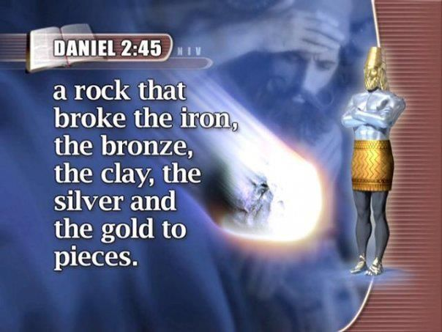
THE ROCK (JESUS)
DESTROYS THE IMAGE
(8 KINGDOMS)
JESUS SETS UP HIS EVERLASTING KINGDOM
THERE WILL BE NO OTHER KINGDOM

Slide 14



