Slide 1














The Order of God
Biblical Finances:
Money and the Workplace

Slide 2





Biblical Finances – WHY?
Everyone has an opinion
"The lack of money is the root of all evil." — Mark Twain
"Money often costs too much." — Ralph Waldo Emerson
"Money talks – mine is always saying ‘good buy’!" — ChatGPT
“Debt is very good” - Robert Kiyosaki
“All Debt is bad” - Dave Ramsey
"Money is a terrible master but an excellent servant." — P.T. Barnum
"Too many people spend money they haven't earned to buy things they don't want, to impress people they don't like." — Will Rogers

Slide 3
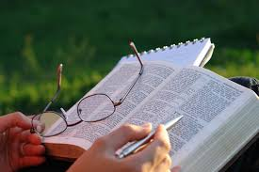
Biblical Finances – WHY?
The bible has a lot to say about Money (Spiritual & Physical)
Money is very closely tied to our heart (a very emotive issue)
“For where your treasure is, there your heart will be also” Mat 6:21
We need to renew our mind (what have we been conformed to? Rom 12)
Do we desire to Glorify God in all things? (Rich young ruler. Mat 19:16-22)
Worship Money / Worship God with our Money
Can’t serve 2 masters - Mat 6:24
We need the Lord & the Truth to encourage us when we mess up!
“And we know that all things work together for good to those who love God, to those who are the called according to His purpose.” Rom 8:28

Slide 4
Key Biblical Principles
Stewardship
Work
Warnings
Provision
Giving
Gratitude
Planning

Slide 5

Stewardship
Matthew 25:14-30
God Owns it ALL - Psalm 24:1 "The earth is the Lord’s, and everything in it."
God Gives us Responsibility. Requires a Return - Sow and Grow
Faithful vs Unfaithful - 1 Cor 4:2 "Now it is required that those who have been given a trust must prove faithful."
We Are Held to Account - Rom 14:12 "So then, each of us will give an account of ourselves to God."
Trust vs Fear and Unbelief
Eternal Rewards / Loss (Enter Thy Rest) Good and Faithful Servant

Slide 6

Work
Work to Add Value - Col 3:23 "Whatever you do, work at it with all your heart, as working for the Lord."
Work is Good & Normal. - Genesis, Prov 14:23 "All hard work brings a profit, but mere talk leads only to poverty."
Work to Earn well - 2 Thes 3:10 - "If anyone is not willing to work, let him not eat.“
What are we ultimately working for? - Mat 6:33 "But seek first His kingdom and His righteousness, and all these things will be given to you as well."

Slide 7

Warnings
Against the love of money. 1 Tim 6:9-10 - “But those who desire to be rich fall into temptation and a snare, and into many foolish and harmful lusts which drown men in destruction and perdition. For the love of money is a root of all kinds of evil, for which some have strayed from the faith in their greediness and pierced themselves through with many sorrows.
The Parable of the Rich Fool: Luke 12:15-21 -“Then he said to them, ‘Watch out! Be on your guard against all kinds of greed; life does not consist in an abundance of possessions.’”
Guarding Against Greed: Mark 8:36 - “What good is it for someone to gain the whole world, yet forfeit their soul?”

Slide 8

Provision
God is Your Provider – We can Trust Him for All our Needs - Philippians 4:19 - "And my God will meet all your needs according to the riches of His glory in Christ Jesus.“
Provide for Yourself and Family - 1 Timothy 5:8 - "Anyone who does not provide for their relatives...has denied the faith.“
Provide for the needs of others - Ephesians 4:28 - Let him who stole steal no longer, but rather let him labor, working with his hands what is good, that he may have something to give him who has need.

Slide 9

Gratitude
Grateful - 1 Thes 5:18 – "Give thanks in all circumstances; for this is God’s will for you in Christ Jesus.“
Contentment - Phil 4:11-12 – "I have learned to be content whatever the circumstances."
Guilt-Free – James 1:17 “Every good and perfect gift is from above”

Slide 10
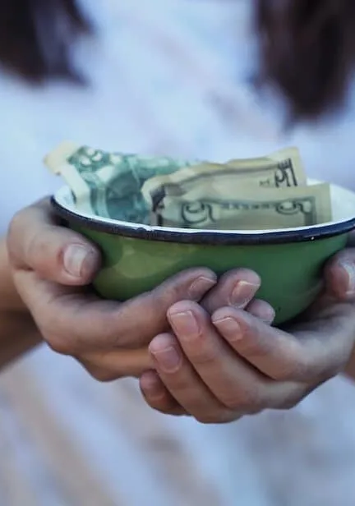
Giving
Freely Receive, Freely Give
Matthew 10:8 – "Freely you have received; freely give."
Be a Generous Giver without Compulsion
2 Corinthians 9:7 – "Each of you should give what you have decided in your heart to give, not reluctantly or under compulsion, for God loves a cheerful giver."
Sharing and Having All Things in Common
Acts 2:44-45 – "All the believers were together and had everything in common. They sold property and possessions to give to anyone who had need."
Tithes, Offerings, and Alms Giving
Malachi 3:10 – "Bring the whole tithe into the storehouse, that there may be food in my house."

Slide 11

Planning
Study Yourself – Get knowledge, understanding and wisdom.
Budget – If you don’t aim at something you will never hit it.
Save (yes this is Godly) - For specific items and difficult times
Leave and inheritance – Spiritual is far more significant that physical but physical is good.

Slide 12


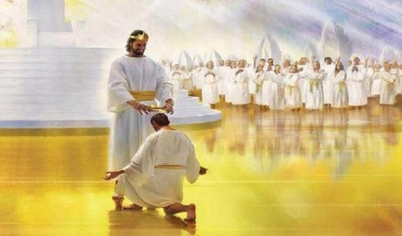

“Well done, good and faithful servant”

