Slide 1
Biblical Marriage

Slide 2

This mystery is great; but I am speaking with reference to Christ and the church.
- Ephesians 5:32
Marriage symbolises Christ's union with the Church, emphasising its deep spiritual significance beyond earthly partnership.
Notes:
Turn to Ephesian 5
When Paul (by the HOLY Spirit) talks about marriage, He relates it directly to Christ and the Church. Our marriages are a key part of our faith and testimony.

Slide 3
Therefore a man shall leave his father and his mother and hold fast to his wife, and they shall become one flesh. - Genesis 2:24 (ESV) | Ephesians 5:31
Notes:
The Holy Spirit tells us here that we become one flesh when we get married. Once again, this is a picture of Christ and HIS church.
We are no longer two individuals. Two separate, independent lives (and histories) are meshed together

Slide 4

COVENANT
GOD has joined you together
Notes:
This is a covenant that you have made before GOD, not just men.
It speaks to the covenant HE has made with believers. All HIS promises to us are HIS covenant with us. Our side of the covenant is to believe in Christ and then live that belief out in every part of our lives.

Slide 5
GOD's Order for Marriage

Slide 6
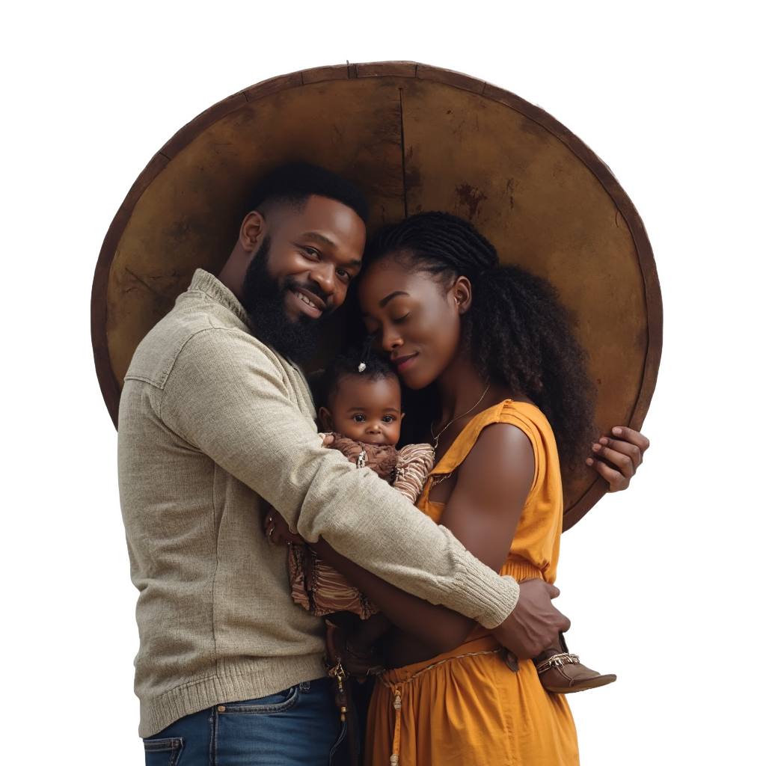
For the husband is the head of the wife, as Christ also is the head of the church, He Himself being the Saviour of the body.
- Ephesians 5:23
Husbands are called to lead their own households (under the headship of JESUS), balancing strength with gentleness in protecting and providing.

Slide 7
Wives, be subject to your own husbands, as to the Lord. … But as the church is subject to Christ, so also the wives ought to be to their husbands in everything.
- Ephesians 5:22, 24
Wives are called to submit to their own husbands.

Slide 8

JESUS
Instructs, Empowers and Guides
HUSBAND
Protects & Provides for the Family
Fulfils the Will of GOD
WIFE
Children and Household in Order

Slide 9
JESUS
SATAN
Instructs, Empowers and Guides
Destroys the Family
Children
HUSBAND
WIFE
Protects & Provides for the Family
Fulfils the Will of GOD
Allows Satan access to the Children
Disempowers the Husband
WIFE
HUSBAND
Children and Household in Order
Household in Disorder
The will of GOD unfulfilled

Slide 10
Husbands

Slide 11
25 Husbands, love [ἀγαπάω (agapaó)] your wives, as Christ loved the church and gave himself up for her, 26 that he might sanctify her, having cleansed her by the washing of water with the word, 27 so that he might present the church to himself in splendor, without spot or wrinkle or any such thing, that she might be holy and without blemish. 28 In the same way husbands should love their wives as their own bodies. He who loves his wife loves himself. - Ephesians 5:25-28 (ESV)

Slide 12
ἀγαπάω (agapaó):
1. Selfless, sacrificial love: This form of love is not based on feelings or emotions but on a deliberate choice to seek the highest good for the other person. It reflects the same love Christ demonstrated for the Church, which is why Paul emphasises it in the context of marriage. This love is self-giving, unconditional, and focused on the well-being of the spouse.

Slide 13
ἀγαπάω (agapaó):
2. Divine love: In the New Testament, ἀγαπάω is most often used to describe God’s love for humanity and the love believers are called to demonstrate, reflecting the nature of God. This love is more than human affection; it aligns with God’s character—pure, holy, and unending.

Slide 14
ἀγαπάω (agapaó):
3. Active, not passive: ἀγαπάω is not just a feeling of affection. It involves action. To “love” in this sense is to actively serve, protect, and care for the wife, just as Christ acted to love the Church by giving Himself up for her. It’s a love that is demonstrated through deeds, not simply words or emotions.

Slide 15
7 You husbands in the same way, live with your wives in an understanding way, as with someone weaker, since she is a woman; and show her honor as a fellow heir of the grace of life, so that your prayers will not be hindered. - 1 Peter 3:7 (NASB)

Slide 16
Wives

Slide 17
22 Wives, submit to your own husbands, as to the Lord. 23 For the husband is the head of the wife even as Christ is the head of the church, his body, and is himself its Savior. 24 Now as the church submits to Christ, so also wives should submit in everything to their husbands. - Ephesians 5:22-24 (ESV)

Slide 18
SUBMIT ≈ agree to refer a matter to a another for decision

Slide 19
9 Likewise, I want women to adorn themselves with proper clothing, modestly and discreetly, not with braided hair and gold or pearls or costly garments, 10 but rather by means of good works, as is proper for women making a claim to godliness. 11 A woman must quietly receive instruction with entire submissiveness. - 1 Timothy 2:9-11 (NASB)

