Slide 1
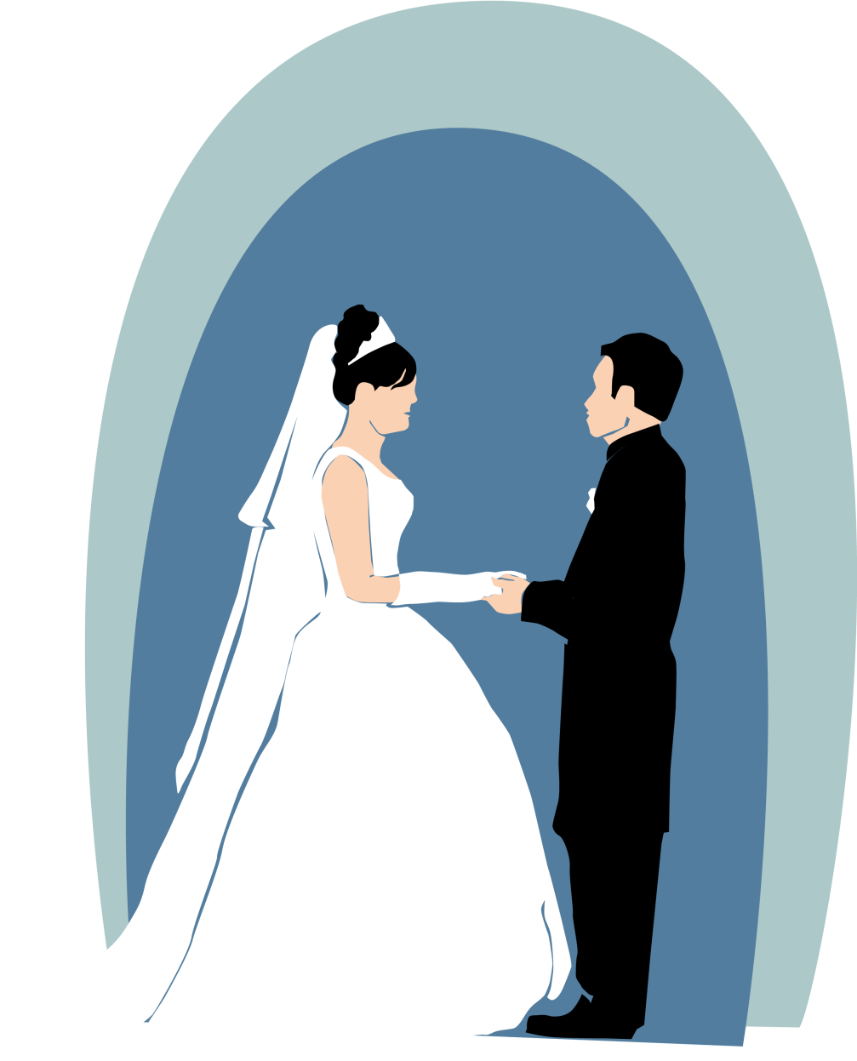
Gods Perfect Plan in
Marriage
(Wives)
Eph 5:32 This mystery is great; but I am speaking with reference to Christ and the church.

Slide 2
Order of God in
Marriage
Eph 5:22 Wives, be subject to your own husbands, as to the Lord.
Eph 5:23 For the husband is the head of the wife, as Christ also is the head of the church, He Himself being the Savior of the body.

Slide 3
Role of Woman
1Tim 5:14 Therefore, I want younger widows to 1) get married, 2)bear children, 3)keep house, and give the enemy no occasion for reproach
Get married and remarry
Bear children (Blessing, gift , saved)
Keep (Manage) (ESV) your household
Oikodespoteō
oikos Meaning "house" or "household."
despotēs Meaning "master" or "lord."
Preside Plan Provide

Slide 4
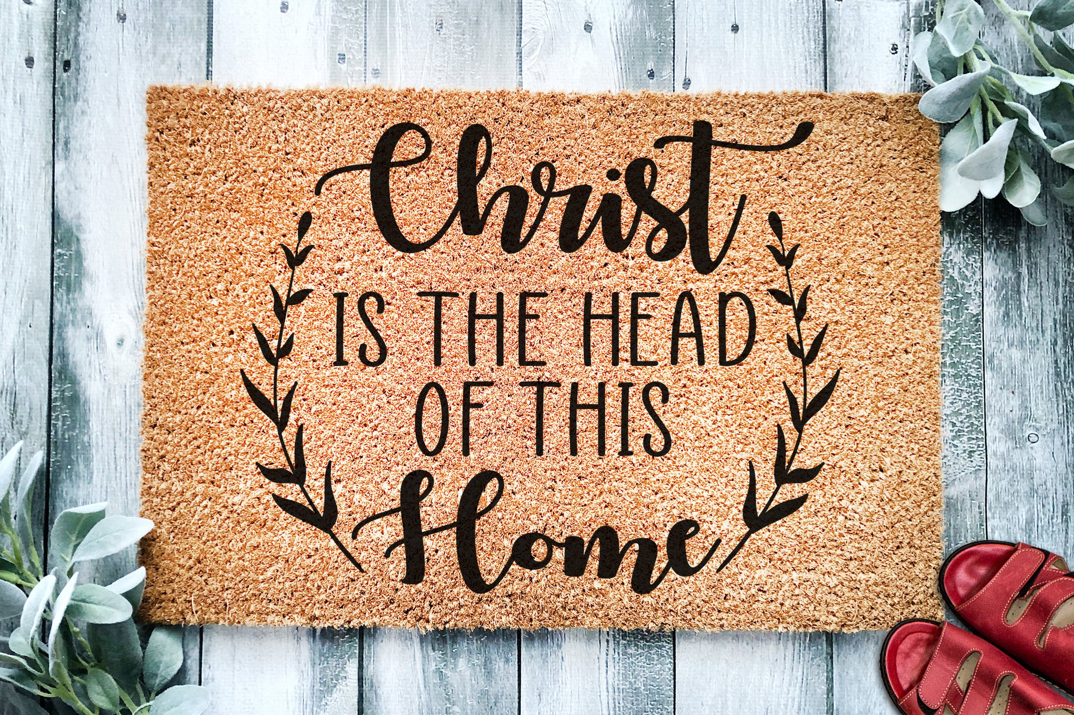
Gen2v21 Adam there was not found a helper suitable for him.

Slide 5
Character/Roles of the Wife
Tit 2:3 Older women likewise are to be reverent in their behavior, not malicious gossips nor enslaved to much wine, teaching what is good,Tit 2:4 so that they may encourage the young women to 1)love their husbands, to 2)love their children,Tit 2:5 to be 3)sensible, 4)pure, 5)workers at home, 6)kind, being 7)subject to their own husbands, so that the word of God will not be dishonored.
Love their husbands
Love their children
Be Sensible (Serious & Self Controlled)
Pure
Workers at Home
Kind

Slide 6
Character/Roles of the Wife cont.
7) Tit 2:5 subject to their own husbands
Def: HUPOTASSO
(hupo-): Preposition meaning "under" or "beneath."
(tassō): Verb meaning "to arrange," "to set in order"
To whom? Ans: to their own husbands
Manner of Submission: “as to the Lord” (Eph. 5:22b)
Measure of Submission: “submit to your husbands in everything” (Eph.5:24b)
1Cor 7:4 The wife does not have authority over her own body, but the husband does; and likewise also the husband does not have authority over his own body, but the wife does.

Slide 7
