Slide 1

Notes:
Some advise for young people thinking of becoming parents…
Practical steps to take to see if you’re ready for parenting…
Tong in cheek, but many of those have reality as it’s source…
Such a large topic… difficult to do it justice in such a short space of time.
Chip Ingram… Craig – House and Home, effective parenting…

Slide 2


Notes:
One of the Key Principles that God calls us to is….. Stewardship.

Slide 3
STEWARDSHIP
Train up a child in the way he should go: and when he is old, he will not depart from it.
Proverbs 22 v 6
Children are a gift from the LORD; they are a reward from him.
Psalm 127 v 3
Notes:
As a people God commissioned us to take care of the earth and the animals.
There is the Stewardship of material possessions and finances (John, next week)
For most of us though, the Stewardship of raising children, will be the greatest of our lives.
Our children will be our greatest challenge, greatest joy, greatest pain, but ultimately, hopefully our greatest reward.
2 Scriptures to back this up….

Slide 4


Notes:
There are a few timeless principles that can create the environment which can help us achieve this promise of our children being a great Reward.
No guarantees. But strong correlation.
Why do we need to? I turned out OK and parents just muddled along.
Firstly this is something that you don’t want to leave to chance.
Secondly, our children are growing up in a completely different world.
Village raising a child.
Need to be on our A game.
In light of this… Effective parenting begins with clear-cut objectives.
If you don’t have a target you’ll hit it every time

Slide 5



Happiness
Holiness
Notes:
We need to have a target
What is your target? Happiness or Holiness (set apart)
Centered around SELF, Centered around Jesus and others - JOY
Become independent… Shift dependence from you to the Lord
Happiness - Parent out of Fear instead of Focus.
Worried if our child will fit in with…. And you can fill in the blanks. Aways changing. No clear
Counter-culture.
As Cath reminder us last week. The only instruction in the Bible to Children…

Slide 6
Children, it is your Christian duty to obey your parents, for this is the right thing to do. “Respect your father and mother” is the first commandment that has a promise added: 3“so that all may go well with you, and you may live a long time in the land.”
Ephesians 6:1-3
Notes:
Instruction to Parents….

Slide 7
Fathers, don’t exasperate your children or make it difficult for them to obey the commandment. Bring them up with Christian teaching in Christian discipline.
Ephesians 6:4
Notes:
Literal Standard Version
And the fathers: do not provoke your children, but nourish them in the instruction and admonition of the LORD.
Efffectively, as parents we need to teach our children to Obey
The word Obedience is ….

Slide 8
Fathers, don’t exasperate your children or make it difficult for them to obey the commandment. Bring them up with Christian teaching in Christian discipline.
Ephesians 6:4
Notes:
Ultimate goal as parents is for our children to obey the commandment….
…Come under the obedience of Christ.
First they need to Obey us as Parents. How can they Obey God whom they cannot see, if they can’t obey us?
The word Obedience is ….

Slide 9
hupaakouo
Obedience is teaching your child to come UNDER the HEARING of your voice.
Notes:
Hupa – under
Akouo – sound – acoustics
How and when do we do this?
All the time….

Slide 10
4Hear, O Israel! The LORD is our God, the LORD is one! 5And you shall love the LORD your God with all your heart and with all your soul and with all your might. 6These words, which I am commanding you today, shall be on your heart. 7You shall teach them diligently to your sons and shall talk of them when you sit in your house and when you walk by the way and when you lie down and when you rise up. 8You shall bind them as a sign on your hand and they shall be as frontals on your forehead. 9You shall write them on the doorposts of your house and on your gates.
Deuteronomy 6:4-9
Notes:
Literal Standard Version of Eph 6:4
Fathers, do not provoke your children, but nourish them in the instruction and admonition of the LORD.
How doe we create an environment to encourage this?
Widely accepted that children have 2 primary needs….

Slide 11
SIGNIFICANCE
SECURITY
Do you LOVE me?
Where are the BOUNDARIES?
Notes:
Significance and Security.
Lovely illustration of the need for Boundaries… Kids in a field.
For Parenting, Discipline is the mechanism to show / remind your child when they have crossed on of these boundaries.

Slide 12
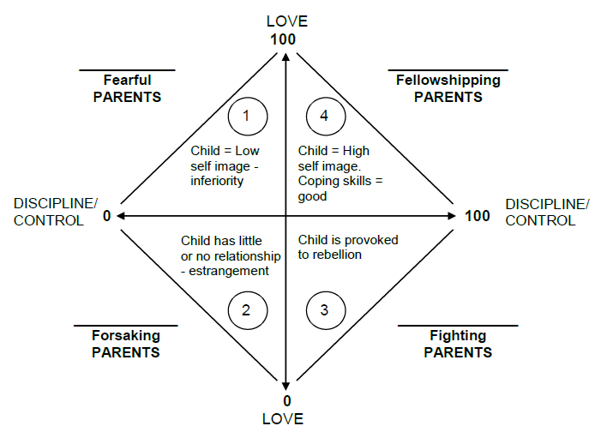
Reuben Hill Case Study
PERMISSIVE
AUTHORITATIVE
NEGLETFUL
AUTHORITARIAN
Notes:
Reuben Hill Case Study
Secular empirical evidence says God's way is the best way.
We would all like to be in the 4th quadrant.
Besides Love and Discipline, how do we lead our kids there and keep them there?
Need to ….Practice what we Preach.

Slide 13
Effective parenting demands we PRACTICE what we PREACH.
The principle of modeling
“More is caught than taught”
Notes:
Takkie hits the tar.
Paul said imitate me as I imitate Christ.
Christ is our example.
We need to be our kids example, so they can transfer from us to Jesus.
To do this, we need to build relationships that bond

Slide 14
build relationships that BOND
UNCONDITIONAL love
Scheduled TIME
FOCUSED attention
EYE contact
ONGOING communication
Meaningful TOUCH
Have FUN together
PRAY together often
Notes:
All this = Time
Spell Love T.I.M.E.
Myth of Quality Time vs Quantity Time
Study: Average father spent 37 seconds per week with meaningful conversation with their kids.
Turn off the TV
Eat Together – significant, last supper
Bedtime – stories, prayer
The Principles of Love and Boundaries and Building relationships are key for the entire parenting process and beyond. However, in our endeavour to shift Obedieance from us to Christ, our role as parents needs to shift through the different ages.

Slide 15
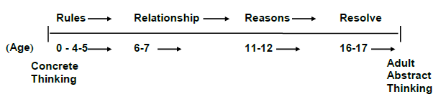




Commander
Instructor
Coach
Consultant
Notes:
Chart by Lawrence Kohlberg
1. Principle of readiness - Only teach children what they are mentally and emotionally capable of learning.
2. Principle of responsibility - Never habitually do for your children what they can do for themselves.
Often have this the wrong way around.

Slide 16
Commander
Instructor
Coach
Consultant
Principle of readiness - Only teach children what they are mentally and emotionally capable of learning.
Principle of responsibility - Never habitually do for your children what they can do for themselves.
Notes:
Negotiating with a 3 year old and laying down the law with your teenager.
Child headed households,
Tying the lases of a 10 year old.
Teenagers lying on the couch asking why supper isn’t ready yet.
Letting out the kite.

Slide 17
Discipline v Punishment
Punishment is retribution
Discipline is teaching obedience to God through consequences and actions in an atmosphere of love.
Short term pain for long term gain
Short term peace for long term pain
Notes:
All this = Time
Myth of Quality Time vs Quantity Time
Study: Average father spent 37 seconds per week with meaningful conversation with their kids.
Turn off the TV
Eat Together – significant, last supper
Bedtime – stories, prayer

Slide 18
He who withholds his rod hates his son, but he who loves him disciplines him diligently. Proverbs 13:24
Folly is bound up in the heart of a child, but the rod of discipline will drive it far away. Proverbs 22:15
My son, do not despise the LORD’s discipline, and do not resent His rebuke, because the LORD disciplines those He loves, as a father the son he delights in. Proverbs 3:11-12

Slide 19
Practical Steps to Discipline
Establish responsibility / boundaries
Clear warning
Use contracts (older kids)
Don’t ask why, establish what
Consequences
Communicate grief
Sincere repentance.
Unconditional LOVE.
Notes:
Don’t ask Why?

Slide 20
YES
YES
YES
NO!
YES
YES
YES
YES
YES
YES
YES
YES

Slide 21
Notes:
Asked my kids what they enjoyed and what they would do differently…
It’s not things. They want you…

