Slide 1

THE
ORDER
OF
GOD

Slide 2
Genesis 1:24-31
²⁶ Then God said, “Let us make man^{[h]} in our image, after our likeness. And let them have dominion over the fish of the sea and over the birds of the heavens and over the livestock and over all the earth and over every creeping thing that creeps on the earth.”
²⁷ So God created man in his own image,
in the image of God he created him;
male and female he created them.
²⁸ And God blessed them. And God said to them, “Be fruitful and multiply and fill the earth and subdue it, and have dominion over the fish of the sea and over the birds of the heavens and over every living thing that moves on the earth.” ²⁹ And God said, “Behold, I have given you every plant yielding seed that is on the face of all the earth, and every tree with seed in its fruit. You shall have them for food. ³⁰ And to every beast of the earth and to every bird of the heavens and to everything that creeps on the earth, everything that has the breath of life, I have given every green plant for food.” And it was so. ³¹ And God saw everything that he had made, and behold, it was very good. And there was evening and there was morning, the sixth day.

Slide 3
Genesis 2:15-24
¹⁵ The Lord God took the man and put him in the garden of Eden to work it and keep it.¹⁶ And the Lord God commanded the man, saying, “You may surely eat of every tree of the garden,¹⁷ but of the tree of the knowledge of good and evil you shall not eat, for in the day that you eat^{[d]} of it you shall surely die.”
¹⁸ Then the Lord God said, “It is not good that the man should be alone; I will make him a helper fit for^{[e]} him.” ¹⁹ Now out of the ground the Lord God had formed^{[f]} every beast of the field and every bird of the heavens and brought them to the man to see what he would call them. And whatever the man called every living creature, that was its name. ²⁰ The man gave names to all livestock and to the birds of the heavens and to every beast of the field. But for Adam^{[g]} there was not found a helper fit for him. ²¹ So the Lord God caused a deep sleep to fall upon the man, and while he slept took one of his ribs and closed up its place with flesh. ²² And the rib that the Lord God had taken from the man he made^{[h]} into a woman and brought her to the man. ²³ Then the man said,
“This at last is bone of my bones
and flesh of my flesh;
she shall be called Woman,
because she was taken out of Man.”^{[i]}
²⁴ Therefore a man shall leave his father and his mother and hold fast to his wife, and they shall become one flesh. ²⁵ And the man and his wife were both naked and were not ashamed.

Slide 4
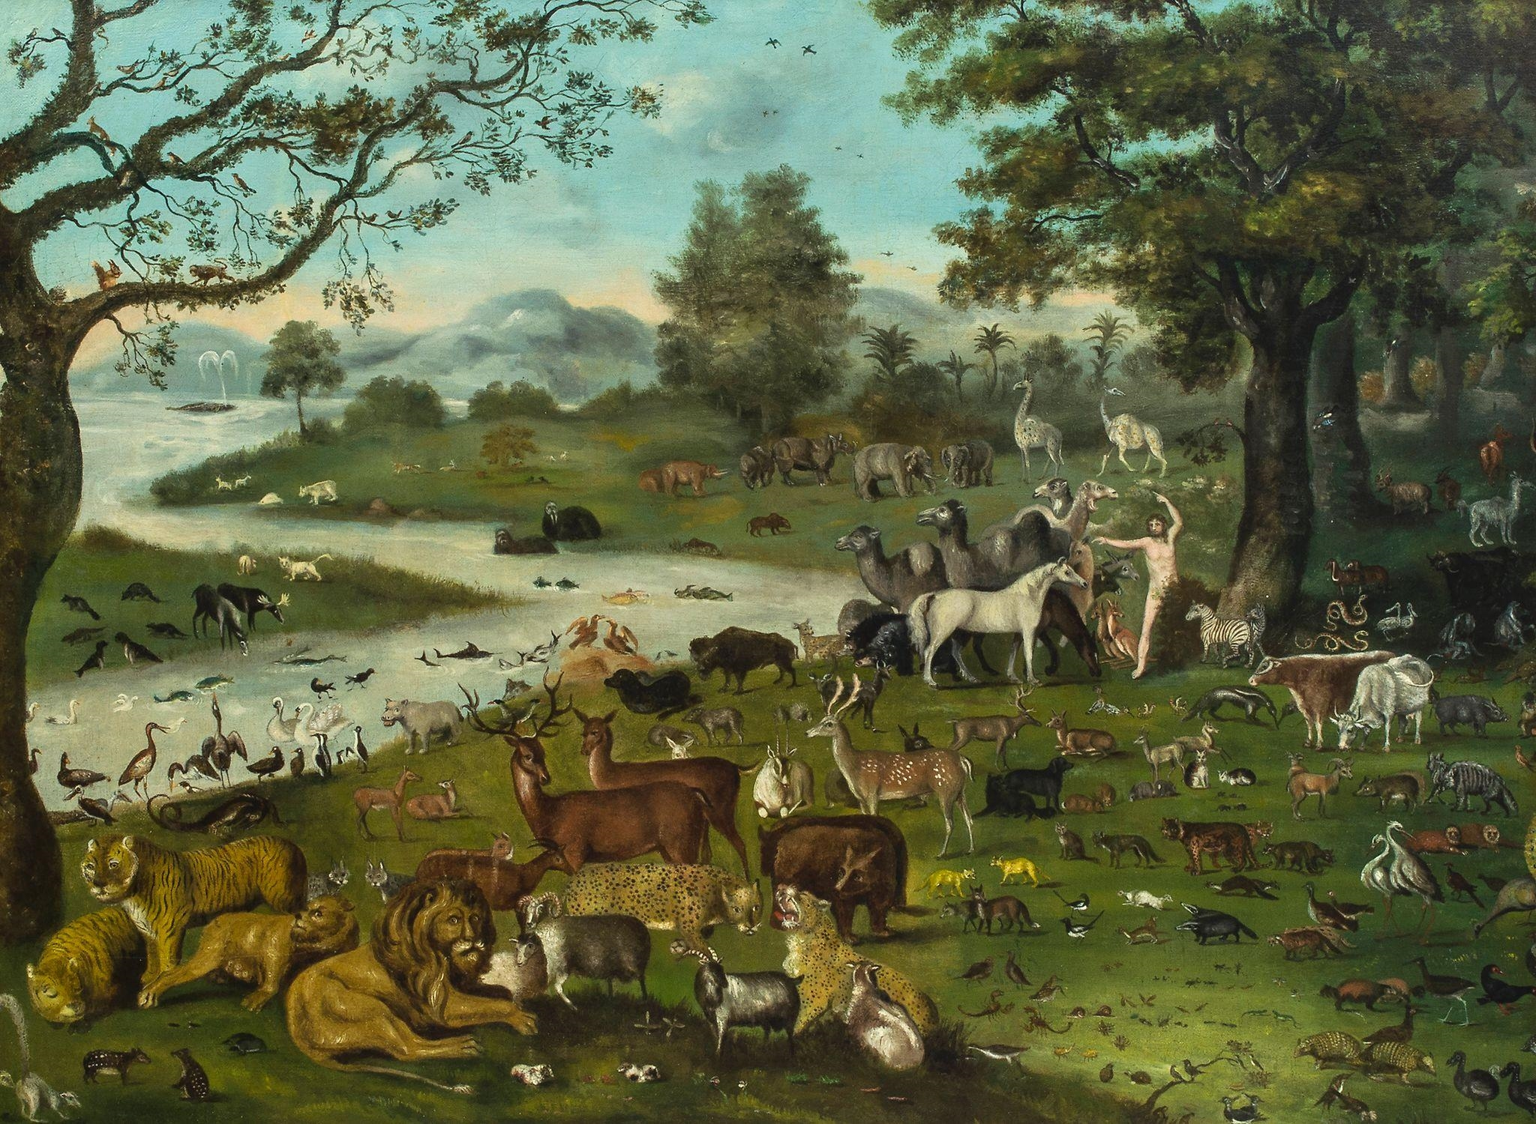

Slide 5
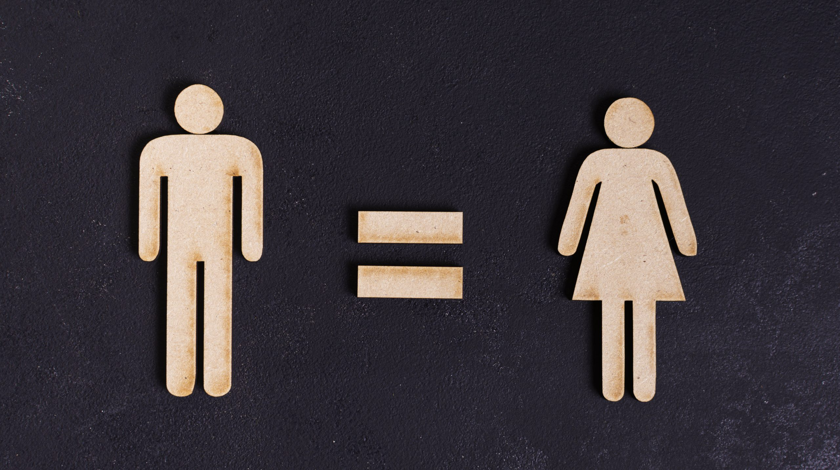
God made men and women to be co-governors of equal value but each having different roles.

Slide 6

SUBMISSION
“the action of accepting or yielding to a superior force or to the will or authority of another person.“

Slide 7

SUBMISSION
“Submitting to one another out of reverence for Christ.”
Ephesians 5:21
“Submission is to voluntarily take a position where you put your trust in someone else and heed their leadership.”
“Submission is the spiritual discipline that frees us from the everlasting burden of always needing to get our own way.”

Slide 8
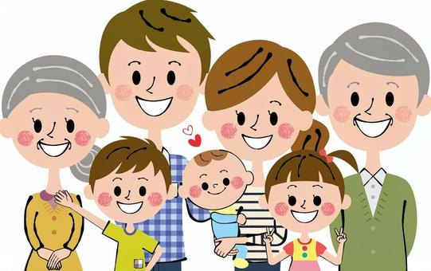

Slide 9


Slide 10
Genesis 3:1-19
3 Now the serpent was more crafty than any other beast of the field that the Lord God had made.
He said to the woman, “Did God actually say, ‘You^{[a]} shall not eat of any tree in the garden’?” ² And the woman said to the serpent, “We may eat of the fruit of the trees in the garden, ³ but God said, ‘You shall not eat of the fruit of the tree that is in the midst of the garden, neither shall you touch it, lest you die.’” ⁴ But the serpent said to the woman, “You will not surely die. ⁵ For God knows that when you eat of it your eyes will be opened, and you will be like God, knowing good and evil.” ⁶ So when the woman saw that the tree was good for food, and that it was a delight to the eyes, and that the tree was to be desired to make one wise,^{[b]} she took of its fruit and ate, and she also gave some to her husband who was with her, and he ate. ⁷ Then the eyes of both were opened, and they knew that they were naked. And they sewed fig leaves together and made themselves loincloths.
⁸ And they heard the sound of the Lord God walking in the garden in the cool^{[c]} of the day, and the man and his wife hid themselves from the presence of the Lord God among the trees of the garden. ⁹ But the Lord God called to the man and said to him, “Where are you?”^{[d]} ¹⁰ And he said, “I heard the sound of you in the garden, and I was afraid, because I was naked, and I hid myself.” ¹¹ He said, “Who told you that you were naked? Have you eaten of the tree of which I commanded you not to eat?” ¹² The man said, “The woman whom you gave to be with me, she gave me fruit of the tree, and I ate.” ¹³ Then the Lord God said to the woman, “What is this that you have done?” The woman said, “The serpent deceived me, and I ate.”

Slide 11

^{Genesis 3:16-19}
¹⁶ To the woman he said,
“I will surely multiply your pain in childbearing;
in pain you shall bring forth children.
Your desire shall be contrary to^{[f]} your husband,
but he shall rule over you.”
¹⁷ And to Adam he said,
“Because you have listened to the voice of your wife
and have eaten of the tree
of which I commanded you,
‘You shall not eat of it,’
cursed is the ground because of you;
in pain you shall eat of it all the days of your life;
¹⁸ thorns and thistles it shall bring forth for you;
and you shall eat the plants of the field.
¹⁹ By the sweat of your face
you shall eat bread,
till you return to the ground,
for out of it you were taken;
for you are dust,
and to dust you shall return.”

Slide 12
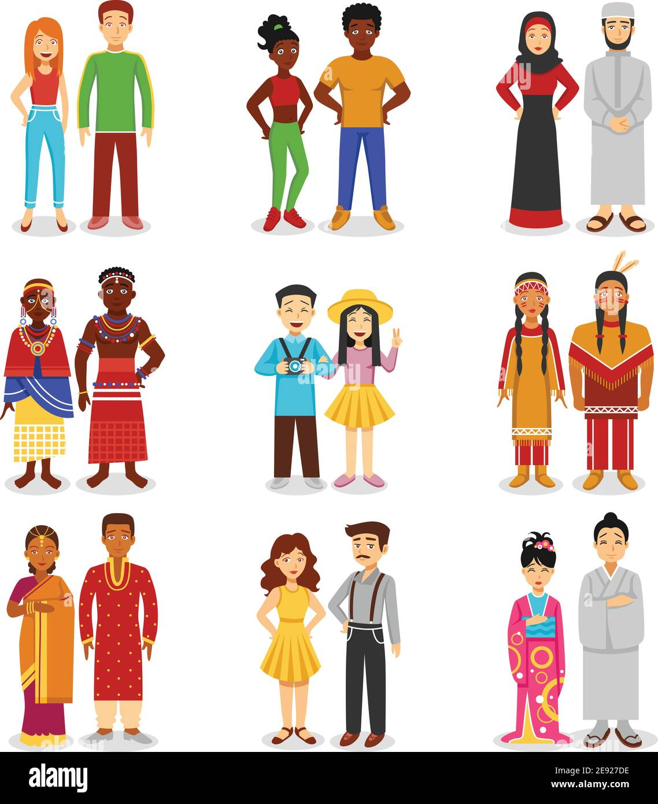
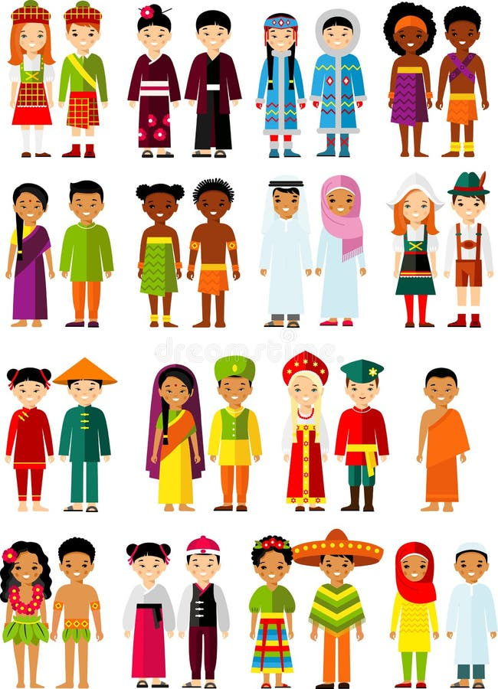

Slide 13


Slide 14


Slide 15


Slide 16
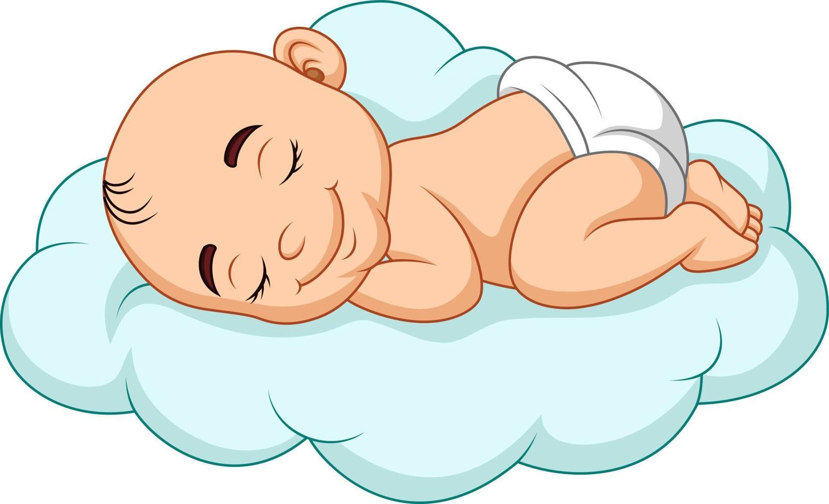
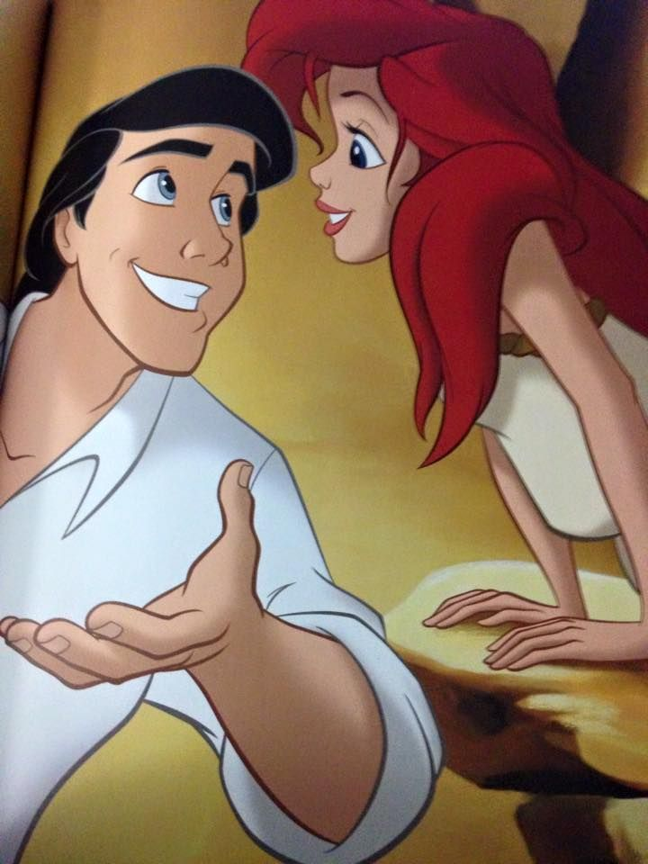
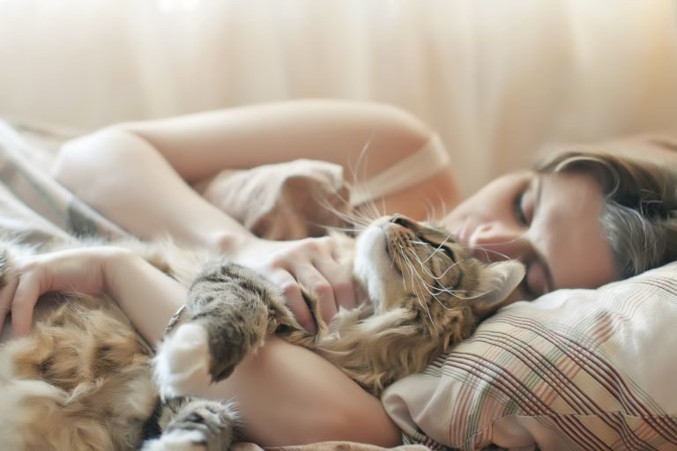

Slide 17


Slide 18

She can’t tell the difference between a boy and a girl and is going to teach us…..University degrees truly are worthless.
Good morning my non-binary, cisgender, genderfluid, transgender free spirits.
My pronouns are he, her, them, us.
Today we are going to learn about indoctrination………I mean how what I teach you over rules God, the Bible and your parents instructions.

Slide 19
Colossians 3:18-20
¹⁸ Wives, submit to your husbands, as is fitting in the Lord.
¹⁹ Husbands, love your wives, and do not be harsh with them.
²⁰ Children, obey your parents in everything, for this pleases the Lord.

