Slide 1
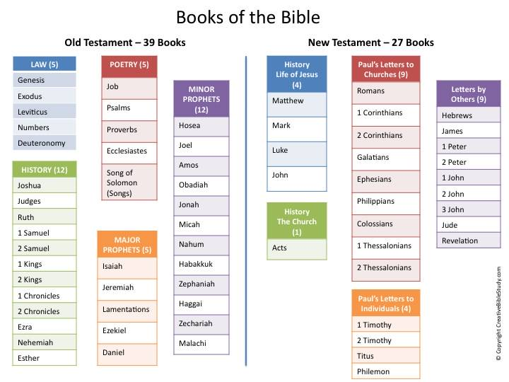

Slide 2
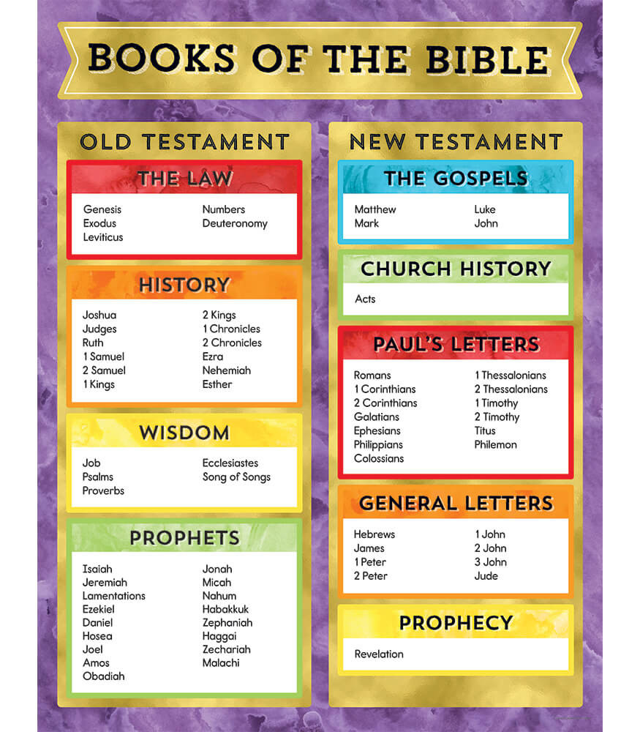
How did the bible come about ?
Jesus Christ
Christ is the word .Abiding in Christ is abiding in his word.
Written by men under Inspiration of the Holy spirit
^{Jn 15:7} “If you abide in Me, and My words abide in you
Around 40 very different men. separated by a very long time
Jn 8:31 So Jesus was saying to those Jews who had believed Him, “If you continue in My word, then you are truly disciples of Mine;
Jn 8:32 and you will know the truth, and the truth will make you free.”
Foundation
Of
Christ
Prophets, kings, statesmen, herdsmen, fishermen, pastors, soldiers and an ex-Pharisee
shepherd, physician, tent maker , fisherman , tax collector
Manifestation of Christ
of Christ
Preparation
For
Christ
Propagation of Christ
Over 3 continents
Timeline (1400BC to 90AD)
Different languages
(Hebrew, Aramaic, and Greek)
Interpretation
of
Christ
Attributes of the Bible(Jesus)
Aspiration
of
Christ
Infallible
Inerrant
Interpretation
of
Christ
Ex36v33 middle bar through centre from end to end
  Sufficient
Expectation
Promises
Of Christ
Eternal
One continuous story
Coronation of Christ
Complete
One plan of salvation
Consummation in Christ
Authoritative
One central theme

Slide 3
Summary of the OT
Luke 24:44 Now He said to them, “These are My words which I spoke to you while I was still with you, that all things which are written about Me in the Law of Moses and the Prophets and the Psalms must be fulfilled.”
1) Moses- “Torah” these are the first 5 books, otherwise known as the Pentateuch
2) The Prophets- “Nebhiim”(Nevi'im)- these are divided into two groups
  The former prophets – these are historical Books from Joshua to Kings (except Ruth)
  The Later prophets- these are the prophetical books from Isaiah to Malachi (except lamentations)
3) The Psalms – “Kethubhim” (Ketuvim )- these are the sacred writings from Chronicles to the song of Solomon plus Ruth, Daniel and Lamentations

Slide 4
1.Law 2.Prophets 3.Poetry
Law – Includes history & creation , Includes Israel’s guide to holiness and worship.
2) Prophets – God’s specific message to man including foretelling of the future.
3) Poetry – Including songs of God’s greatness and His dealings with man.

Slide 5
The Hebrew Old Testament
Law | Prophets | Writings
1. Genesis | A. Former Prophets | A. Poetical Writings
2. Exodus | 6. Joshua | 14. Psalms
3. Leviticus | 7. Judges | 15. Proverbs
4. Numbers | 8. Samuel (1&2) | 16. Job
5. Deuteronomy | 9. Kings (1&2) | B. Five scrolls (Megilloth)
 | B. Latter Prophets | 17. Song of Solomon
 | 10. Isaiah | 18. Ruth
 | 11. Jeremiah | 19. Lamentations
 | 12. Ezekiel | 20. Ecclesiastes
 | 13. The Twelve (minor prophets) | 21. Esther

Slide 6
C. Historical Books
22. Daniel
23. Ezra-Nehemiah
24. Chronicles (1&2)

Slide 7
The Progress of Revelation: Old Testament
Book | Approximate Writing Date | Author
1. Job | Unknown | Anonymous
2. Genesis | 1445–1405 b.c. | Moses
3. Exodus | 1445–1405 b.c. | Moses
4. Leviticus | 1445–1405 b.c. | Moses
5. Numbers | 1445–1405 b.c. | Moses
6. Deuteronomy | 1445–1405 b.c. | Moses
7. Psalms | 1410–450 b.c. | Multiple Authors
8. Joshua | 1405–1385 b.c. | Joshua
9. Judges | c. 1043 b.c. | Samuel
10. Ruth | c. 1030–1010 b.c. | Samuel (?)
11. Song of Solomon | 971–965 b.c. | Solomon
12. Proverbs | 971–686 b.c. | Solomon primarily
13. Ecclesiastes | 940–931 b.c. | Solomon
14. 1 Samuel | 931–722 b.c. | Anonymous
15. 2 Samuel | 931–722 b.c. | Anonymous
16. Obadiah | 850–840 b.c. | Obadiah
17. Joel | 835–796 b.c. | Joel
18. Jonah | c. 760 b.c. | Jonah
19. Amos | c. 755 b.c. | Amos
20. Hosea | 755–710 b.c. | Hosea

Slide 8
21. Micah | 735–710 b.c. | Micah
22. Isaiah | 700–681 b.c. | Isaiah
23. Nahum | c. 650 b.c. | Nahum
24. Zephaniah | 635–625 b.c. | Zephaniah
25. Habakkuk | 615–605 b.c. | Habakkuk
26. Ezekiel | 590–570 b.c. | Ezekiel
27. Lamentations | 586 b.c. | Jeremiah
28. Jeremiah | 586–570 b.c. | Jeremiah
29. 1 Kings | 561–538 b.c. | Anonymous
30. 2 Kings | 561–538 b.c. | Anonymous
31. Daniel | 536–530 b.c. | Daniel
32. Haggai | c. 520 b.c. | Haggai
33. Zechariah | 480–470 b.c. | Zechariah
34. Ezra | 457–444 b.c. | Ezra
35. 1 Chronicles | 450–430 b.c. | Ezra (?)
36. 2 Chronicles | 450–430 b.c. | Ezra (?)
37. Esther | 450–331 b.c. | Anonymous
38. Malachi | 433–424 b.c. | Malachi
39. Nehemiah | 424–400 b.c. | Ezra

Slide 9
Importance of Israel

Slide 10
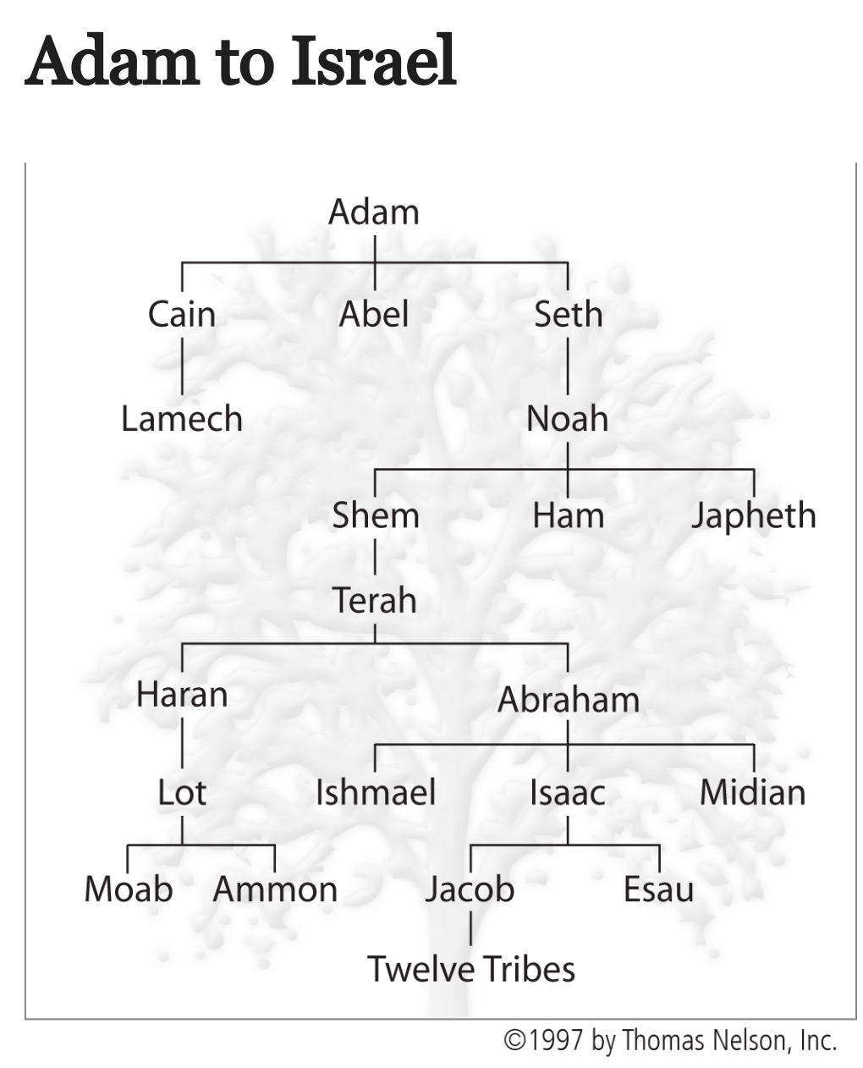

Slide 11
Importance of Jesus in the OT
Fulfilling the Sacrifices , Offerings and Feasts

Slide 12
Old Testament Sacrifices Compared to Christ’s Sacrifice
Leviticus |  | Hebrews
1. Old Covenant (temporary) | Heb. 7:22; 8:6, 13; 10:20 | 1. New Covenant (permanent)
2. Obsolete promises | Heb. 8:6–13 | 2. Better promises
3. A shadow | Heb. 8:5; 9:23–24; 10:1 | 3. The reality
4. Aaronic priesthood (many) | Heb. 6:19–7:25 | 4. Melchizedekian priesthood (one)
5. Sinful priesthood | Heb. 7:26, 27; 9:7 | 5. Sinless priest
6. Limited-by-death priesthood | Heb. 7:16, 17, 23, 24 | 6. Forever priesthood
7. Daily sacrifices | Heb. 7:27; 9:12, 25, 26; 10:9, 10, 12 | 7. Once-for-all sacrifice
8. Animal sacrifices | Heb. 9:11–15, 26; 10:4–10, 19 | 8. Sacrifice of God’s Son
9. Ongoing sacrifices | Heb. 10:11–14, 18 | 9. Sacrifices no longer needed
10. One year atonement | Heb. 7:25; 9:12, 15; 10:1–4, 12 | 10. Eternal propitiation
© 1997 by Thomas Nelson, Inc.

Slide 13
Christ in the Levitical Offerings
 | Offering | Christ’s Provision | Christ’s Character
1. | Burnt Offering | atonement | Christ’s sinless nature | Lev. 1:3–17; 6:8–13
2. | Grain Offering | dedication/ consecration | Christ was wholly devoted to the Father’s purposes | Lev. 2:1–16; 6:14–23
3. | Peace Offering | reconciliation/ fellowship | Christ was at peace with God | Lev. 3:1–17; 7:11–36
4. | Sin Offering | propitiation | Christ’s substitutionary death | Lev. 4:1–5:13; 6:24–30
5. | Guilt Offering | repentance | Christ paid it all for redemption | Lev. 5:14–6:7; 7:1–10
© 1997 by Thomas Nelson, Inc.

Slide 14
Christ Fulfils Israel’s Feasts
The Feasts (Leviticus 23) | Christ’s Fulfillment
Passover (March/April) | Death of Christ (1 Cor. 5:7)
Unleavened Bread (March/April) | Sinlessness of Christ (1 Cor. 5:8)
Firstfruits (March/April) | Resurrection of Christ (1 Cor. 15:23)
Pentecost (May/June) | Outpouring of Spirit of Christ (Acts 1:5; 2:4)
Trumpets (September/October) | Israel’s Regathering by Christ (Matt. 24:31)
Atonement (September/October) | Substitutionary Sacrifice by Christ (Rom. 11:26)
Booths (September/October) | Rest and Reunion with Christ (Zech. 14:16–19)
© 1997 by Thomas Nelson, Inc.

Slide 15
The Prophets
2Pet 1:20 But know this first of all, that no prophecy of Scripture is a matter of one’s own interpretation,
2Pet 1:21 for no prophecy was ever made by an act of human will, but men moved by the Holy Spirit spoke from God.
WWW
Who : Author , Former/Latter
When : Date
Where : From where to whom

Slide 17
Zephaniah | Judah | 635–625 b.c.
Jeremiah | Judah | 627–570 b.c.
Habakkuk | Judah | 620–605 b.c.
Daniel | Babylon | 605–536 b.c.
Ezekiel | Babylon | 593–570 b.c.
Haggai | Judah | 520–505 b.c.
Zechariah | Judah | 520–470 b.c.
Malachi | Judah | 437–417 b.c.

Slide 18
Prophets organized by Captivity
Preexilic |  |  |  | Exilic | Postexilic
Amos | Micah | Jeremiah |  | Daniel | Haggai
Hosea | Nahum | Habakkuk |  | Ezekiel | Zechariah
Jonah | Isaiah | Zephaniah |  |  | Malachi
Obadiah | Joel

Slide 19
New Testament summarized into 3 divisions
1.History – The life of Jesus and the early church.
2.Letters – to specific churches and people for particular reasons.
3.Prophecy – Revelation

Slide 20
The Progress of Revelation: New Testament
Book | Approximate Writing Date | Author
1. James | a.d. 45–49 | James
2. Galatians | a.d. 49–50 | Paul
3. Matthew | a.d. 50–60 | Matthew
4. Mark | a.d. 50–60 | Mark
5. 1 Thessalonians | a.d. 51 | Paul
6. 2 Thessalonians | a.d. 51–52 | Paul
7. 1 Corinthians | a.d. 55 | Paul
8. 2. Corinthians | a.d. 55–56 | Paul
9. Romans | a.d. 56 | Paul
10. Luke | a.d. 60–61 | Luke
11. Ephesians | a.d. 60–62 | Paul
12. Philippians | a.d. 60–62 | Paul
13. Colossians | a.d. 60–62 | Paul

Slide 21
14. Philemon | a.d. 60–62 | Paul
15. Acts | a.d. 62 | Luke
16. 1 Timothy | a.d. 62–64 | Paul
17. Titus | a.d. 62–64 | Paul
18. 1 Peter | a.d. 64–65 | Peter
19. 2 Timothy | a.d. 66–67 | Paul
20. 2 Peter | a.d. 67–68 | Peter
21. Hebrews | a.d. 67–69 | Unknown
22. Jude | a.d. 68–70 | Jude
23. John | a.d. 80–90 | John
24. 1 John | a.d. 90–95 | John
25. 2 John | a.d. 90–95 | John
26. 3 John | a.d. 90–95 | John
27. Revelation | a.d. 94–96 | John

Slide 22
Symbol | Reality | Texts
1. Jesus Christ | Personification of the Word | John 1:1; Rev. 19:13
2. Valuable Metals | Incalculable worth | Ps. 12:6 (silver); Ps. 19:10, 119:127 (gold)
3. Seed | Source of new life | Matt. 13:10–23; James 1:18; 1 Pet
4. Water | Cleansing from sin | Eph. 5:25–27; Rev. 21:6; 22:17
5. Mirror | Self-examination | James 1:22–25
6. Food | Nourishment to the soul | 1 Cor. 3:2, 1 Pet. 2:1–3 (milk); Deut. 8:3, Matt. 4:4 (bread); 1 Cor. 3:3, Heb 5:12–14 (meat); Ps. 19:10 (honey)
7. Clothing | A life dressed in truth | Titus 2:10; 1 Pet. 3:5
8. Lamp | Light for direction | Ps. 119:105; Prov. 6:23; 2 Pet. 1:19
9. Sword | Spiritual weapon | Eph. 6:17 (outwardly); Heb. 4:12 (inwardly)
10. Plumb Line | Benchmark of spiritual reality | Amos 7:8
11. Hammer | Powerful judgment | Jer. 23:29
12. Fire | Painful judgment | Jer. 5:14; 20:9; 23:29
©1997 by Thomas Nelson, Inc.

Slide 23
Our Response
1 Peter 2:2 Desire the word like a new born baby needs milk. Like newborn infants, long for the pure spiritual milk, that by it you may grow up into salvation
2Tim 2:15 Be diligent to present yourself approved to God as a workman who does not need to be ashamed, accurately handling the word of truth.
Deut 6:7 “You shall teach them diligently to your sons and shall talk of them when you sit in your house and when you walk by the way and when you lie down and when you rise up.
Believe it (John 6:68–69)
Study it (Ezra 7:10)
Honor it (Job 23:12)
Love it (Ps. 119:97)
Obey it (1 John 2:5)
Fight for it (Jude 3)
Guard it (1 Tim. 6:20)
Preach it (2 Tim. 4:2)

Slide 24
Quote in front of Gideons Bibles – unknown author
This book contains: the mind of God, the state of man, the way of salvation, the doom of sinners, and the happiness of believers.
Its doctrine is holy, its precepts are binding, its histories are true, and its decisions are immutable. Read it to be wise, believe it to be saved, and practice it to be holy.
It contains light to direct you, food to support you, and comfort to cheer you. It is the traveler’s map, the pilgrim’s staff, the pilot’s compass, the soldier’s sword, and the Christian’s charter. Here heaven is open, and the gates of hell are disclosed.
Christ is the grand subject, our good its design, and the glory of God its end. It should fill the memory, rule the heart, and guide the feet.
Read it slowly, frequently, and prayerfully. It is a mine of wealth, health to the soul, and a river of pleasure. It is given to you here in this life, will be opened at the judgment, and is established forever.
It involves the highest responsibility, will reward the greatest labor, and condemn all who trifle with its contents.

Slide 25
Questions and Answers

