Slide 1




Philemon
Sin Brings Barriers

Slide 2
2Tim 2:15 Be diligent to present yourself approved to God as a workman who does not need to be ashamed, accurately handling the word of truth.
WWW
Who : Author
Paul
When : Date
AD 60-62
Where : From where to whom?
From prison( Rome) to house church at Colossae

Slide 3
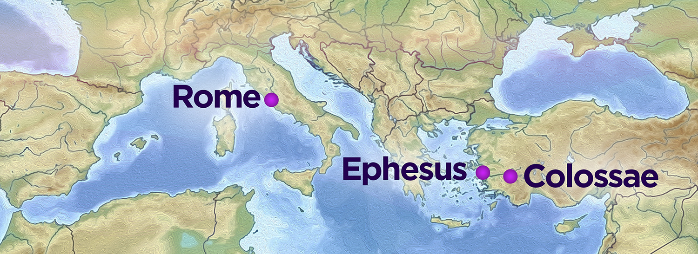
Who Del?
Phm 1:12 I have sent him (Onesimus) back to you in person, that is, sending my very heart,
Delivered by Tychicus who was accompanied by Onesimus.Col 4v7-9
Where?
Pompeii
Who”s House
V1 Philemon our beloved brother and ^{e} fellow worker, >> ^{Phm 1:2} and to Apphia ^{1,a} our sister, and to ^{b} Archippus our ^{c} fellow soldier, and to ^{d} the church in your house: >>

Slide 4
The Progress of Revelation: New Testament
Book | Approximate Writing Date | Author
1. James | a.d. 45–49 | James
2. Galatians | a.d. 49–50 | Paul
3. Matthew | a.d. 50–60 | Matthew
4. Mark | a.d. 50–60 | Mark
5. 1 Thessalonians | a.d. 51 | Paul
6. 2 Thessalonians | a.d. 51–52 | Paul
7. 1 Corinthians | a.d. 55 | Paul
8. 2. Corinthians | a.d. 55–56 | Paul
9. Romans | a.d. 56 | Paul
10. Luke | a.d. 60–61 | Luke
11. Ephesians | a.d. 60–62 | Paul
12. Philippians | a.d. 60–62 | Paul
13. Colossians | a.d. 60–62 | Paul
Who?
When?
14. Philemon a.d 60-62 Paul

Slide 5
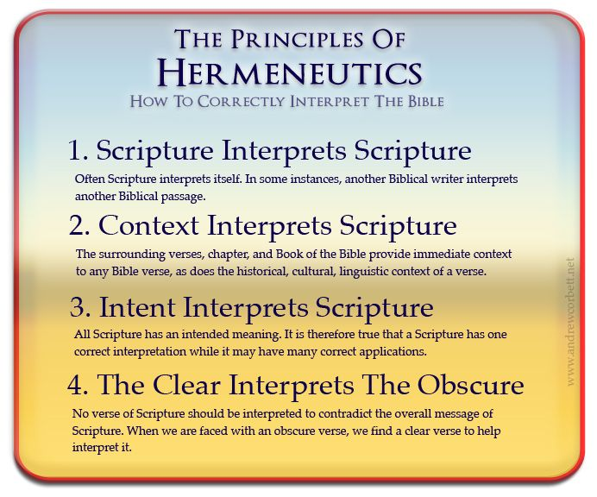

Slide 6
GRAMMAR AND SYNTAX
Syntax : The way in which words are put together to form phrases, clauses, or sentences.
ie the arrangement of words and phrases in a specific order. Eg in English, the typical word order is
Subject-Verb-Object (SVO), as in
I know that She (Subject) reads (Verb) books (Object)
Afrikaans(SOV): Ek weet dat sy boeke lees.(Verb)
Note: If you change the position of even one word, it's possible to change the meaning of the entire sentence.

Slide 7
Causal clause :
Expresses the reason for the action of the verb it develops.
(because, for, since)
Philemon 1:4-5 (ESV)
"I thank my God always when I remember you in my prayers, because I hear of your love and of the faith that you have toward the Lord Jesus and for all the saints,“
Causal Clause: "because I hear of your love and of the faith that you have toward the Lord Jesus and for all the saints“
Explanation: This clause explains why Paul thanks God when he remembers Philemon in his prayers. It is because he has heard of Philemon's love and faith.

Slide 8
Purpose Clause :
Describes the purpose or goal of the verb it develops.
(in order that, that, so that)
Philemon 1:6 (ESV)
"...and I pray that the sharing of your faith may become effective for the full knowledge of every good thing that is in us for the sake of Christ.“
Purpose Clause: "that the sharing of your faith may become effective“
Explanation: This clause explains the purpose of Paul's prayer, which is for the sharing of Philemon's faith to become effective.

Slide 9
  Relative clause:
Acts as an adjective, describing a noun or pronoun.
WWW(who, which, whom, whose)
Philemon 1:10-11 (ESV)
"I appeal to you for my child, Onesimus, whose father I became in my imprisonment. (Formerly he was useless to you, but now he is indeed useful to you and to me.)“
Relative Clause: "whose father I became in my imprisonment"
Explanation: The clause "whose father I became in my imprisonment" modifies "Onesimus" and provides more information about him, ie Paul became metaphorically his spiritual father .1Cor 4:15 b, for in Christ Jesus I became your father through the gospel.

Slide 10
Contrast cause :
Contrasts something with what was just said.
(but, yet, nevertheless)
Philemon 1:13-14 (ESV)
"I would have been glad to keep him with me, in order that he might serve me on your behalf during my imprisonment for the gospel, but I preferred to do nothing without your consent in order that your goodness might not be by compulsion but of your own accord.“
Contrast Clause 1: "but I preferred to do nothing without your consent"
Contrast Clause 2: "but of your own accord"
Explanation: These clauses contrast Paul's desire to keep Onesimus with him and his decision to seek Philemon's consent, and they further contrast Philemon's potential actions being out of compulsion versus of his own free will.

Slide 11
Temperal clause
Tells when the action of the main clause is happening.
(when, while, after, then, since, before, as,ect)
Philemon 1:15 (ESV)
"For this perhaps is why he was parted from you for a while, that you might have him back forever,“
Temporal Clause: "for a while"
Explanation: This clause indicates the duration of Onesimus's separation from Philemon, suggesting a temporary period of time.

Slide 12
Comparison clause
: Introduces a comparison. (as, even as, just as, so)
Philemon 1:16 (ESV)
"no longer as a bondservant but more than a bondservant, as a beloved brother—especially to me, but how much more to you, both in the flesh and in the Lord.“
Comparison Clause: "no longer as a bondservant but more than a bondservant, as a beloved brother"
Explanation: This clause compares Onesimus's previous status as a bondservant to his new status as a beloved brother, emphasizing the transformation in his relationship with Philemon.

Slide 13
Conditional clause
: Establishes a condition that must be true before the main clause will
come to pass. (if, unless)
Philemon 1:17 (ESV)
"So if you consider me your partner, receive him as you would receive me."
Conditional Clause: "if you consider me your partner"
Explanation: This clause sets the condition for Philemon's action of receiving Onesimus. If Philemon considers Paul a partner, then he should receive Onesimus as he would receive Paul.
Philemon 1:18 (ESV)
"If he has wronged you at all, or owes you anything, charge that to my account."
Conditional Clause: "If he has wronged you at all, or owes you anything"
Explanation: This clause sets up two potential conditions regarding Onesimus's actions—1)wronging Philemon or 2)owing him anything—and provides a resolution to these conditions.

Slide 14
Result clause
: Describes the result of the clause it develops.
(therefore, as a result, so, thus, so that)
Philemon 1:21 (ESV)
"Confident of your obedience, I write to you, knowing that you will do even more than I say."
Result Clause: "that you will do even more than I say"
Explanation: This clause expresses the anticipated result of Paul's letter to Philemon, which is Philemon's obedience and willingness to do more than Paul requests.

Slide 15
V1-3 Greeting & Intro | V4-7 Looking back | V8-19 Looking within | V20-25 Looking beyond

Slide 16
V1-3 Greeting & Intro | V4-7 Looking back | V8-19 Looking within | V20-25 Looking beyond
Perspective | Appreciation Commendation | Appeal (love not apostolic authority) Compassion | Anticipation Confidence v21

Slide 17
V1-3 Greeting & Intro | V4-7 Looking back | V8-19 Looking within | V20-25 Looking beyond
Perspective | Appreciation Commendation | Appeal (love not apostolic authority) Compassion | Anticipation Confidence v21
Tone Heart Forgiveness | Praise Enjoyment The Character of One Who Forgives (4–7) | Plea Exhortation The Actions of One Who Forgives (8–18) | Promise Expectation The Motives of One Who Forgives (19–25)

Slide 18

You may not forget but you can chose to forgive
70 x7 Times Math 18 v22
Eph 4:32 Be kind to one another, tender-hearted, forgiving each other, just as God in Christ also has forgiven you.

Slide 19
Questions and Answers

