Slide 1


Slide 2
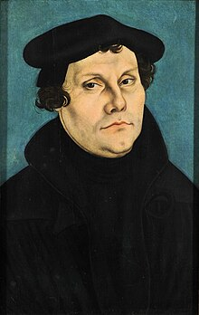
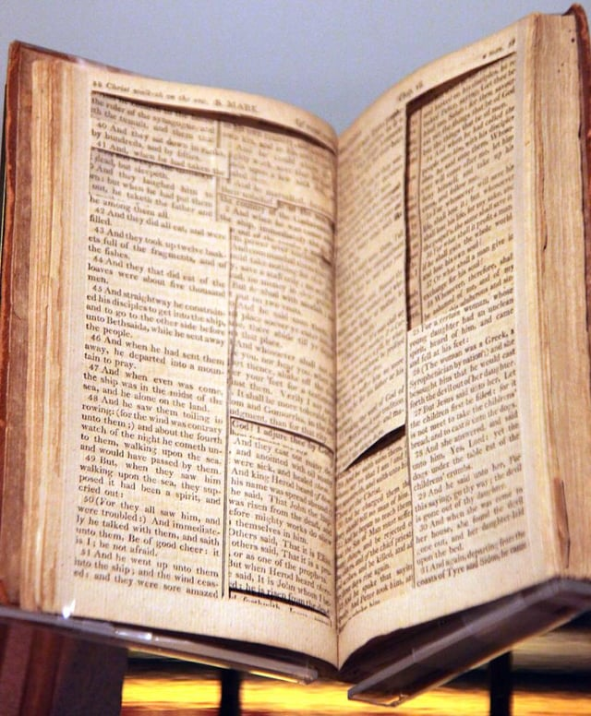
“We should throw the
Epistle of James out of this school.”
“Therefore St James’ epistle is really an epistle of straw, compared to these others, for it has nothing of the nature of the gospel about it”

Slide 3
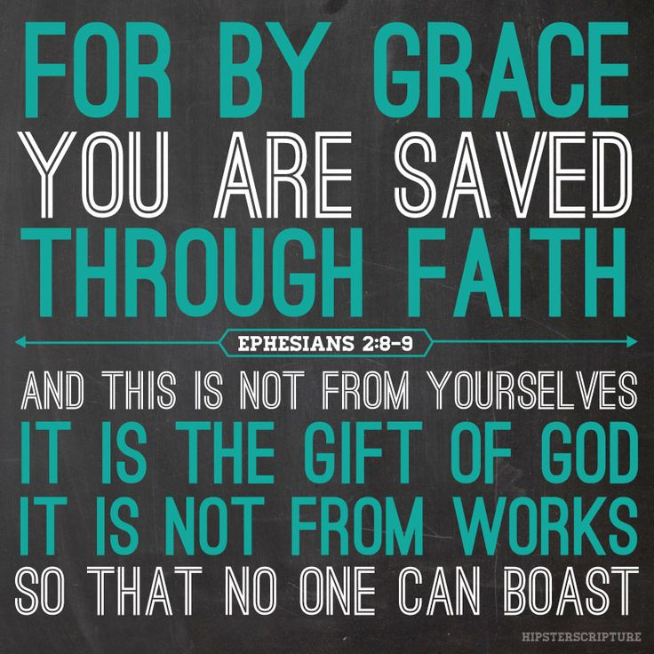
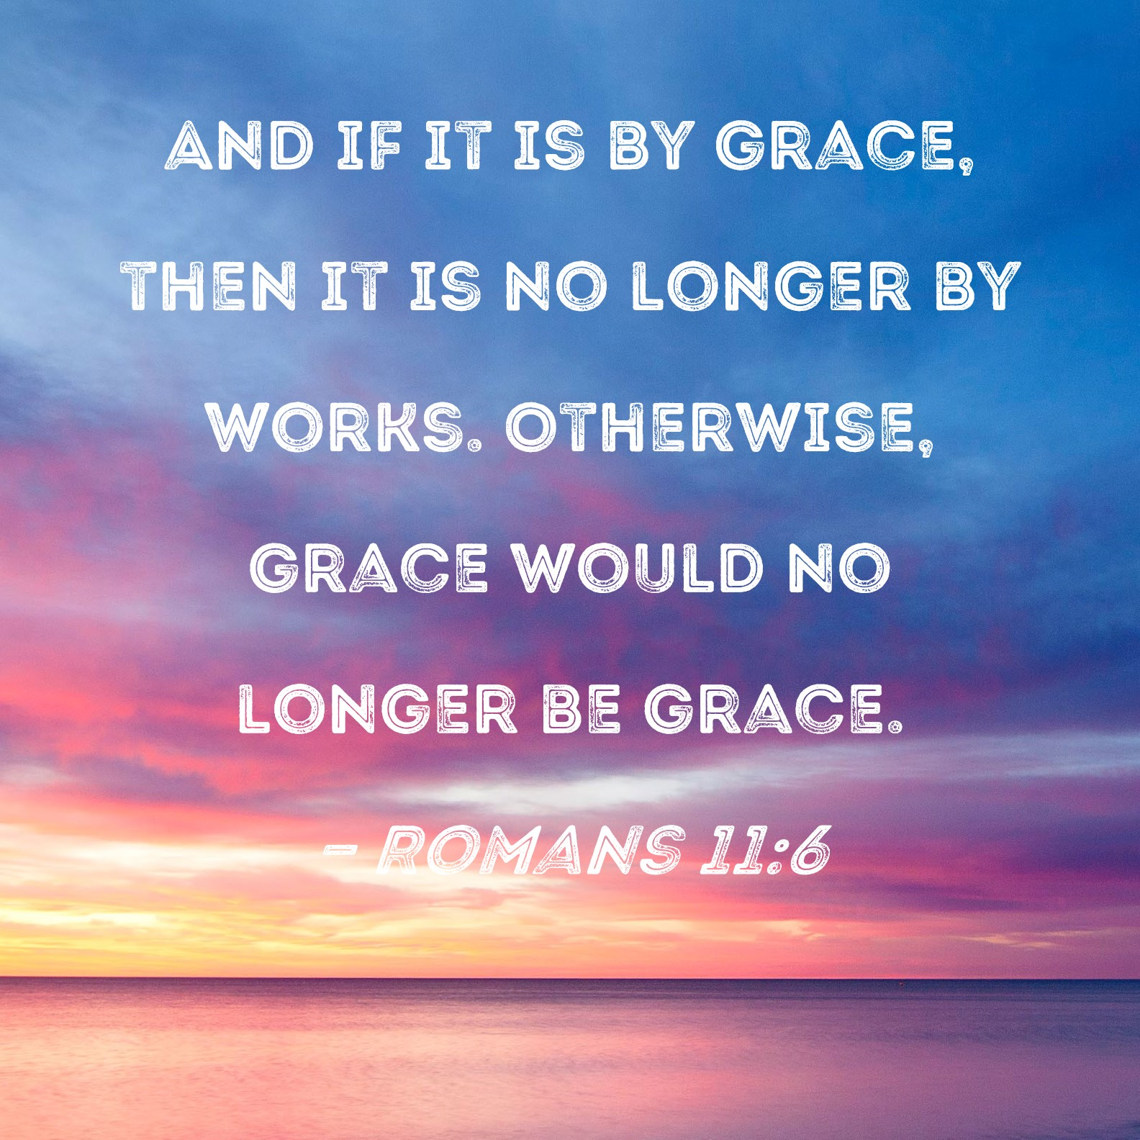
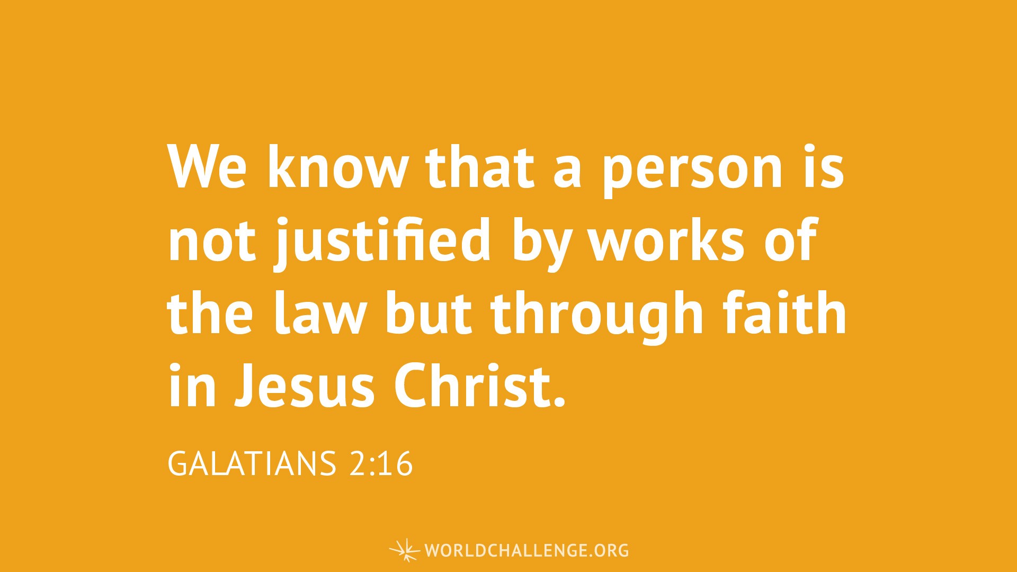

Slide 4


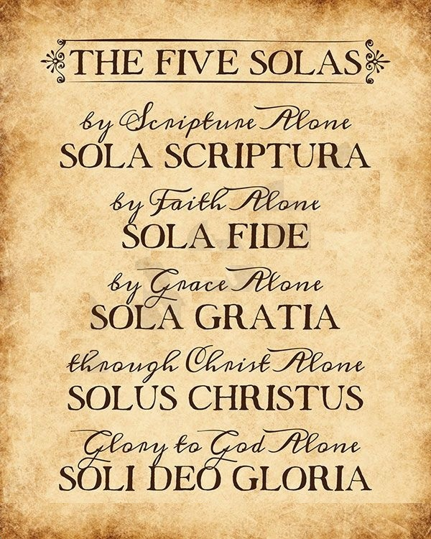



Scriptural but NOT Scripture

Slide 5
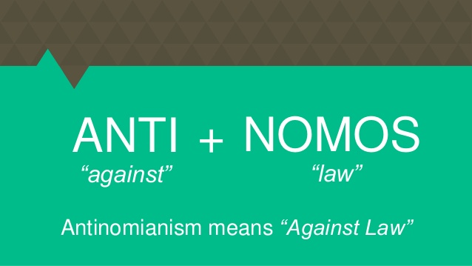
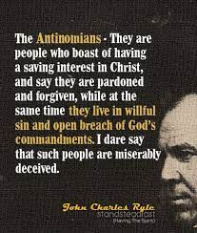
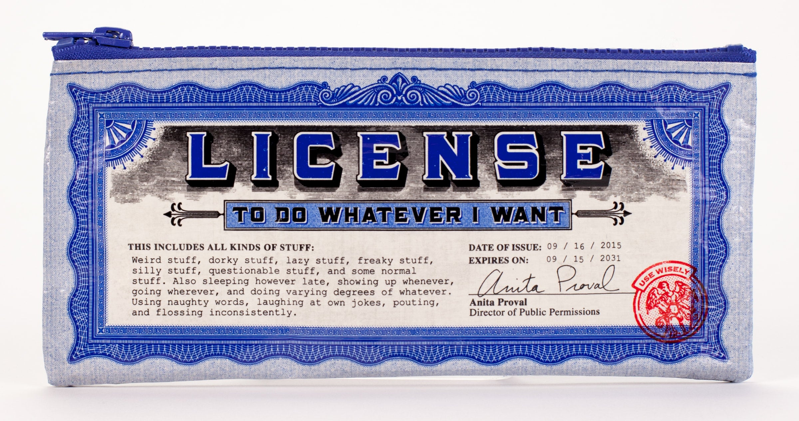

Slide 6
Ephesians 2:8-10
⁸ For by grace you have been saved through faith. And this is not your own doing; it is the gift of God,⁹ not a result of works, so that no one may boast.¹⁰ For we are his workmanship, created in Christ Jesus for good works, which God prepared beforehand, that we should walk in them.

Slide 7
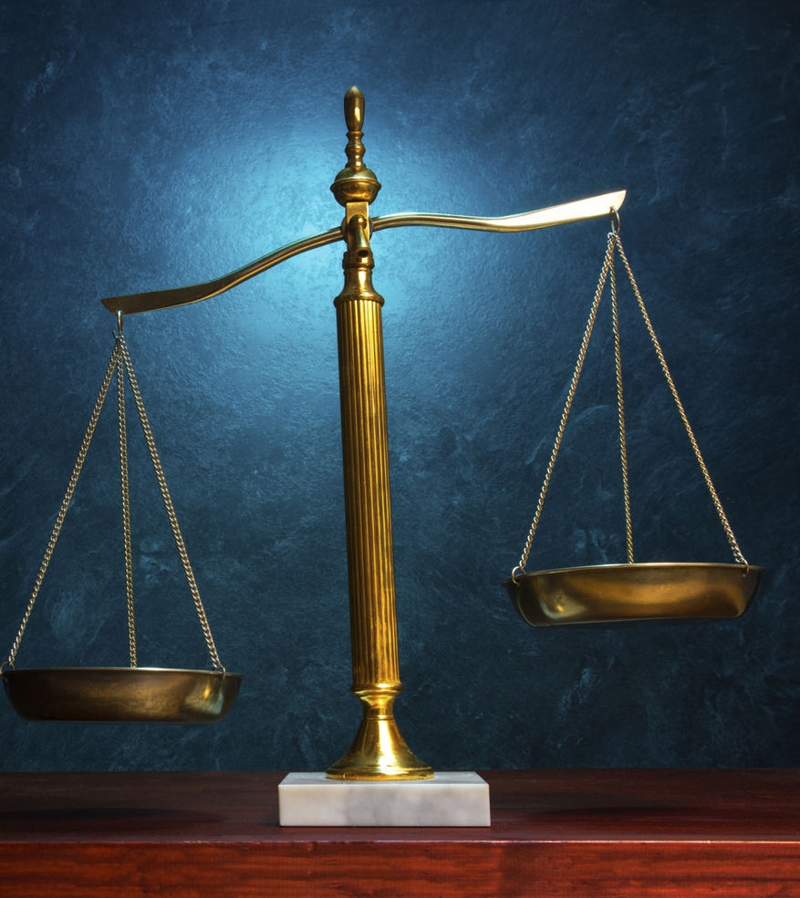
James is not writing about how to become a Christian
but
how to act like a Christian.

Slide 8
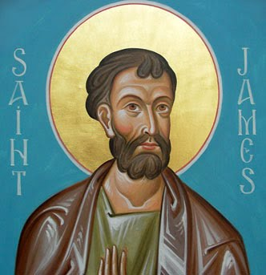
Legalist
“What good is it, my brothers, if someone says he has faith but does not have works? Can that faith save him?”

Slide 9
Parallels between James and Jesus Sermon on the Mount
James | Teaching | Matthew
1:2 | joy amid trials | 5:10–12
1:4 | exhortation to be perfect | 5:48
1:5 | asking God for good things | 7:7–11
1:17 | God the giver of good | 7:11
1:20 | against anger | 5:22
1:22 | hearers and doers of the word | 7:24–27
2:5 | poor inherit the kingdom | 5:3, 5
2:10 | keeping the whole law | 5:19
2:13 | merciful receive mercy | 5:7
James | Teaching | Matthew
3:12 | know them by their fruits | 7:16
3:18 | blessings of peacemakers | 5:9
4:2–3 | ask and you will receive | 7:7–8
4:4 | serving God vs. friendship with the world | 6:24
4:9–10 | consolation for mourners | 5:4
4:11–12 | against judging others | 7:1–5
4:13–14 | living for today | 6:34
5:2–5 | moth and rust spoiling earthly treasures | 6:19
5:10 | prophets as examples and patterns | 5:12
5:12 | against oaths | 5:33–37

Slide 10
James is not writing about how to become a Christian
but
how to act like a Christian.

Slide 11
1 John 3:1-10
See what kind of love the Father has given to us, that we should be called children of God; and so we are. The reason why the world does not know us is that it did not know him.² Beloved, we are God's children now, and what we will be has not yet appeared; but we know that when he appears^{[a]} we shall be like him, because we shall see him as he is.³ And everyone who thus hopes in him purifies himself as he is pure.
⁴ Everyone who makes a practice of sinning also practices lawlessness; sin is lawlessness.⁵ You know that he appeared in order to take away sins, and in him there is no sin.⁶ No one who abides in him keeps on sinning; no one who keeps on sinning has either seen him or known him.⁷ Little children, let no one deceive you. Whoever practices righteousness is righteous, as he is righteous.⁸ Whoever makes a practice of sinning is of the devil, for the devil has been sinning from the beginning. The reason the Son of God appeared was to destroy the works of the devil.⁹ No one born of God makes a practice of sinning, for God's^{[b]} seed abides in him; and he cannot keep on sinning, because he has been born of God.¹⁰ By this it is evident who are the children of God, and who are the children of the devil: whoever does not practice righteousness is not of God, nor is the one who does not love his brother.

