Slide 1

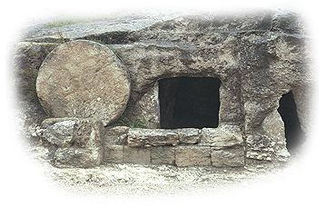
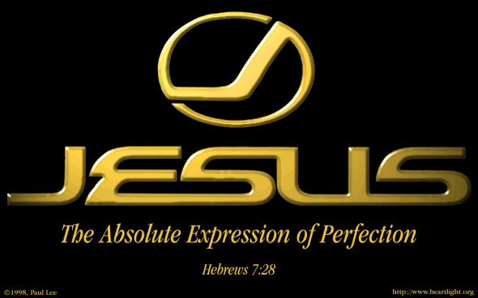

Slide 2
Hermeneutics
Date & grammar present tense
Date of writing: AD 60-70, but not after.
A.D. 70, brought an end- Jewish sacrificial system
The author consistently uses the present tense (“is,” “are”) for the temple and the priestly activities (e.g. Heb. 5:1, 8:4, 9: 25, 10:11)

Slide 3
14. Philemon | a.d. 60–62 | Paul
15. Acts | a.d. 62 | Luke
16. 1 Timothy | a.d. 62–64 | Paul
17. Titus | a.d. 62–64 | Paul
18. 1 Peter | a.d. 64–65 | Peter
19. 2 Timothy | a.d. 66–67 | Paul
20. 2 Peter | a.d. 67–68 | Peter
21. Hebrews | a.d. 67–69 | Unknown
22. Jude | a.d. 68–70 | Jude
23. John | a.d. 80–90 | John
24. 1 John | a.d. 90–95 | John
25. 2 John | a.d. 90–95 | John
26. 3 John | a.d. 90–95 | John
27. Revelation | a.d. 94–96 | John

Slide 4
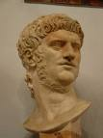
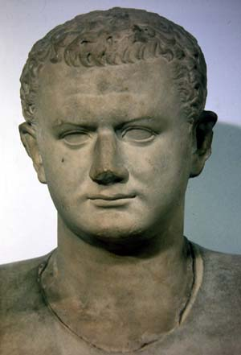
Historical-Critical Approach
Roman Emperor Nero
AD 54-68
Christian Persecutions AD 64
Roman Emperor Titus
Destroyed Jerusalem
AD 70

Slide 5
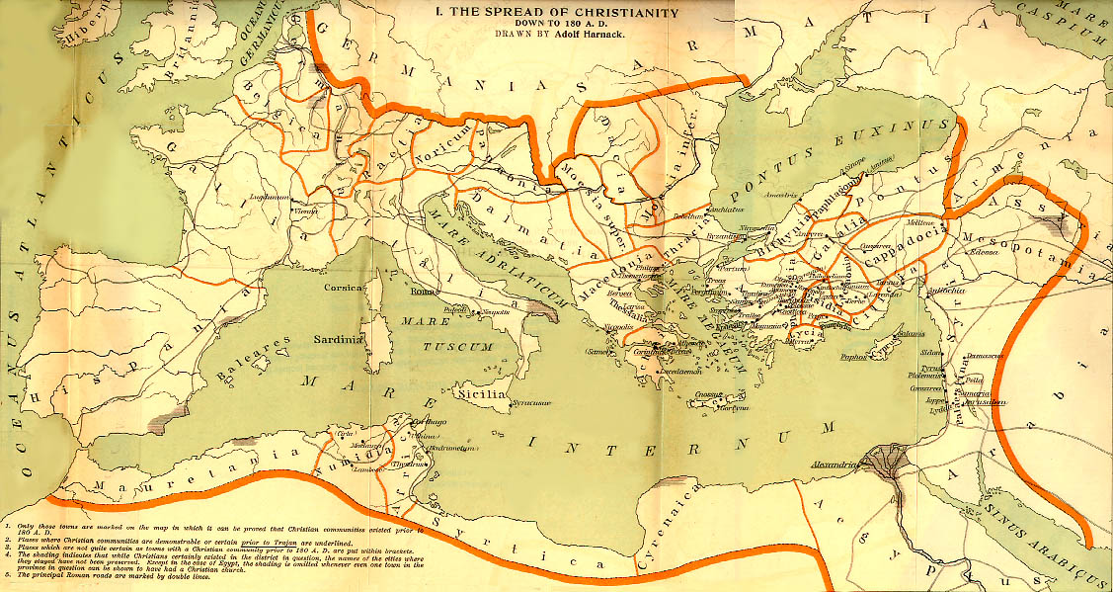
The Roman Empire at the time of Hebrews AD 68
Heb 10:34 For you showed sympathy to the prisoners and accepted joyfully the seizure of your property, knowing that you have for yourselves a better possession and a lasting one.
Qumran
Heb 13:24 Greet all of your leaders and all the saints.
Those from Italy greet you.

Slide 6
Addressee (Recipients)
No specific person or church
Letter to the Hebrews
Recipients Believers (10:32-34)
2. Unbelievers who were intellectually convinced of the gospel (see 2:1-3; 6:4-6; 10:26-29; 12:15-
17)
3. Unbelievers who were attracted by the gospel and the person of Christ but who had reached no final conviction about him (9:11, 14-15, 27-28)

Slide 7
Hebrews – Rooted in Old Testament
Hebrews has 29 quotations and 53 allusions to the Old Testament, for a total of 82 references.
Author was keenly aware of Levitical practices, master of the Greek language, a frequent user of the OT Septuagint and a master homiletician

Slide 8
Introduction
  Not a letter (word of exhortation)
  Heb 13:22 But I urge you, brethren, bear with this word of exhortation, for I have written to you briefly.
  Very elegant Greek
  Oscillates between theology and exhortation
  Sermons?

Slide 9
Chapter 1

Slide 10
THE MAIN POINTS OF
HEBREWS CHAPTER 1
Jesus’ superiority over prophets as spokesman -­ 1: 1-­3
Jesus’ superiority over angels by virtue of His deity -­ 1: 4-14

Slide 11
1:4-14 Jesus is greater than the angels
Angel = messenger, mediator
Greek aggeloi Hebrew malakim
  Archangels Michael (Daniel 10:21) Gabriel (Daniel 8:16, Luke 1:19)
  An angel destroys Jerusalem (2 Sam 24)
  Satan is a “fallen angel”?
  Myriads upon myriads… (Daniel 7:10)
  One angel kills 185,000 Assyrian soldiers. (2 Kings 19:35)

Slide 12
Chapter 2

Slide 13
THE MAIN POINTS OF HEBREWS CHAPTER 2
Warning against drifting away
- 2: 1-­4
Jesus’ superiority over the angels by virtue of His humanity -­ 2: 5-­18

Slide 14
JESUS’ SUPERIORITY OVER THE ANGELS BY VIRTUE OF HIS HUMANITY -­ HEBREWS 2:5-18
Eight reasons Jesus became man. (9-18)
1. To taste death for every one
2. To bring many sons to glory
3. To be made perfect through sufferings
4. To destroy the devil who had the power of death

Slide 15
JESUS’ SUPERIORITY OVER THE ANGELS BY VIRTUE OF HIS HUMANITY -­ HE 2:5-18
5. To release those subject to bondage through fear of death
6. To give aid to the seed of Abraham
7. To be a merciful and faithful High Priest
8. To aid those who are tempted, having suffered temptation Himself

Slide 16
Chapter 3

Slide 17
MAIN POINTS HEBREWS CHAPTER 3
Jesus’ superiority over Moses -­ 3: 1-­6
Warning against departing -­ 3: 7-19

Slide 18
JESUS’ SUPERIORITY OVER MOSES -­ HE 3:1-­6
MOSES AND JESUS COMPARED: (3-­6)
Moses: Faithful and a servant in the house of God
Jesus: Faithful and a Son over and builder of the house of God
Moses: Counted worthy of Glory
Jesus: Counted more Glorious

Slide 19
A WARNING AGAINST DEPARTING -­‐ HE 3:7-­19
THE EXAMPLE OF ISRAEL IN THE WILDERNESS
(v7-11)
Israel Hardened Their Hearts..
Heb.3v 7-11 Is From Ps. 95:7-11
Therefore They Did Not Enter God’s Rest... Num 14:22-24,26-35 cf. Ps. 106:13-33
Notes:
In which the Holy Spirit warned Israel not to be like the fathers in the wilderness
A warning which the Hebrew writer found just as necessary in his day
In the wilderness, the Israelites had...
Hardened their hearts in rebelling against God
Tested (tried) God with their lack of faith
This they did many times during the forty years of wandering, but especially...
At the beginning, with the incident at Massah (tempted)
Meribah (Water) cf. Exo 17:1-7
The rest (of which there were 603,548 men) died in the wilderness

Slide 20
A WARNING AGAINST DEPARTING -­‐ HE 3:7-­19
THREE THINGS THAT CAN LEAD THE CHRISTIAN TO FALL AWAY? (12-­13)
  Developing an evil heart of unbelief
  Departing from the living God
  Becoming hardened through the deceitfulness of sin

Slide 21
A WARNING AGAINST DEPARTING -­‐ HE 3:7-­19
THREE THINGS THAT CAN
PREVENT APOSTASY? (12-14)
  Beware of unbelief
  Exhort one another daily
  Hold the beginning of our confidence steadfast to the end

Slide 22
Chapter 4

Slide 23
MAIN POINTS OF HEBREWS CHAPTER 4
The promised rest (4:1-­10)
A warning against disobedience
­( 4:11-13)
Our great High Priest (4:14-16)

Slide 24
THE PROMISED REST -­ HEBREWS 4:1-­10
THE THREE RESTS:
  Sabbath Rest (He 4:4 cf. Exo 16:23; Gen 2:2)
  Canaan Rest (He 4:8 cf. Deu 3:20; 12:9-10; Josh 1:13-15)
  Heavenly Rest (He 4:9-­10)
Notes:
SABBATH
When first introduced to the nation of Israel, it was spoken of as “the rest of the holy Sabbath unto the LORD” - Exo 16:23
This was the seventh day rest, patterned after God’s own rest following the creation - Gen 2:2
It was encoded into the Law given on tablets of stone - cf. Exo 20:8-11
It was not given to the nation’s fathers (i.e., ancestors such as Abraham, Isaac, Jacob) - cf. Deu 5:2-22; Neh 9:13-14
It was given to Israel as a weekly remembrance of their deliverance from Egypt – Deu 5:12-15
BUT Done away – Col. 2:14-16

Slide 25
OUR GREAT HIGH PRIEST -­ HE 4:14-­16
  SUBJECT INTRODUCED (14-16)
We Have A Great High Priest, Jesus The Son Of God
He Sympathizes With Our Weaknesses, Because He Was Tempted
We Can Approach God’s Throne Boldly, Obtain Mercy And Grace In Time Of Need

Slide 26
Ch4 Salad exhortations
“Let us” exhortations.
  Hebrews 4:1 let us be careful
  Hebrews 4:11 let us, therefore, make every effort
  Hebrews 4:14 let us hold firmly to the faith we profess
  Hebrews 4:16 let us draw near

Slide 27
Chapter 5

Slide 28
THE MAIN POINTS OF HEBREWS CHAPTER 5
Christ’s qualifications as High Priest (Heb. 5:1-­10)
A warning against dullness (Heb. 5:11-­14)

Slide 29
Jesus the Great High Priest
  Can relate to us (Heb 4:15)
  Makes intercession before God for us (Heb 4:16)
  Offer gifts (fragrant offerings) and sacrifices (sin, guilt offering) (Heb 5:1)
  Selected by God from men (Heb 5:1,4-5)
  Represents man to God (Heb 5:1)

Slide 30
Greater than any High Priest
  Serves in the Heavenly Tabernacle, not the earthly one. (Heb 4:14)
  Tempted, yet was without sin. (Heb 4:15)
  Did not need to offer sacrifices for his own sin. (Heb 5:3)
  A priest forever (Heb 5:6)
  A priest from the order of Melchizedek (Heb 5:6)
  Brings us into the real inner sanctuary. (Heb 4:16)

Slide 31
Chapter 6

Slide 32
THE CERTAINTY OF GOD’S PROMISE -­ HEB 6:13­‐20
  1)God’s Promise And 2)God’s Oath
  Both In Which It Is Impossible For God To Lie

Slide 33
Chapter 7

Slide 34
Melchizedek
Without genealogy, without descendants. (Hebrews 7:3)
“Without beginning of days or end of life” (Hebrews 7:3)
A priest forever. (Hebrews 7:3, Psalm 110:4)
The King of Salem (Jerusalem) (Genesis 14:18)
A priest, but not of the family of Levi. (Heb 7:6)
He blessed Abraham. (Genesis 14:19)
Abraham offered him a tithe/sacrifice (Genesis 14:20).

Slide 35
Melchizedek: Prefigure of Christ
Melchizedek means King of Righteousness.
King of Salem means King (prince?) of Peace.
The King of physical Jerusalem.
Without beginning or end of days.
Without descendants.
Greater than Abraham (Heb 7:4, John 8:53-58).
Gave Abraham bread and wine (last supper, Lord’s Supper)
Not a Levite
A priest for everyone; not just for the Jews.
A priest and a king.

Slide 36
SUMMARY HEBREW CHAPTER 7
THE GREATNESS OF MELCHIZEDEK: HEB. 7:1-­10
THE NEED FOR A NEW PRIESTHOOD:­ HEB. 7:11-­19
THE GREATNESS OF JESUS’ PRIESTHOOD: HEB. 7:20-­28

Slide 37
Conclusion:
Hebrews 7:28 The law appoints as high priests men who are weak, but the oath, which came after the law, appointed the Son, who has been made perfect forever.
Hebrews 7:22 Jesus has become the guarantee of a better covenant.

Slide 38
Chapter 8

Slide 39
MAIN POINTS OF HEB CHAPTER 8
THE NEW BETTER MINISTRY OF CHRIST -­ HE 8:1-­6
THE NEW BETTER COVENANT OF CHRIST -­ HE 8:7-­13

Slide 40
THE NEW MINISTRY OF CHRIST -­ HEB. 8:1-­‐6
His location as our High Priest: Seated at the right hand of God
He ministers in The sanctuary and true tabernacle build by God
Better gifts v3

Slide 41
THE NEW COVENANT OF CHRIST -­ HEB 8:7-­13
The Need To Replace The First Covenant With The Second:
The old covenant is about to disappear (AD 70) obsolete. v13

Slide 42
Chapter 9

Slide 43
THE MAIN POINTS OF CHAPTER 9
The earthly sanctuary and its service -­‐ He 9:1-­‐10
The heavenly sanctuary and its sacrifice -­‐ He 9:11-­‐28

Slide 44
THE EARTHLY SANCTUARY
AND ITS SERVICE -­‐ HEB 9:1-­‐10
The two parts of the earthly tabernacle, what they contained (2-­‐5)
  Holy place: lampstand, table of showbread, altar of incense
  (cf. Exo 30:1-­‐7)
  Holiest of All: ark of the covenant, with the items in it, and the mercy seat
The limitations of the earthly tabernacle and its services? (9-­‐10)
  Symbolic, and could not make one perfect

Slide 45
THE HEAVENLY SANCTUARY
AND ITS SACRIFICE -­‐ HEB 9:11-­‐28
What was Christ High Priest is of?: (11,24)
  Of good things to come
  Of the greater and more perfect tabernacle (heaven)
The nature of what Christ offered as sacrifice (12,14)
  His own blood
  Offered without spot
What Christ’s sacrifice accomplished (12,14-­‐15,26,28)
  Eternal redemption (even for transgressions under the first covenant)
  Cleansing consciences from dead works to serve the living God
  To put away sin, once and for all

Slide 46
Chapter 10

Slide 47
MAIN POINT OF CHAPTER 10
The superiority of Christ’s sacrifice -­‐
Heb 10:1-­‐18
Exhortation to draw near and hold fast -­‐
Heb 10:19-­‐25
A warning against despising -­‐
Heb 10:26-­‐39

Slide 48
THE SUPERIORITY OF CHRIST’S SACRIFICE -­‐ HEB 10:1-­‐18
Why animal sacrifices were insufficient (1-­‐4)
  They did not make one perfect
  Because they could not take away sins
What distinguishes Christ’s sacrifice from those of OT priests (11-­‐14)
  He offered one sacrifice for all time
  Capable of perfecting those being sanctified

Slide 49
EXHORTATION TO
DRAW NEAR AND HOLD FAST -­‐ HEB 10:19-­‐25
The three-­‐fold exhortation based on what Jesus has done (22-­‐24)
  Let us draw near
  Let us hold fast
  Let us consider one another
What we should not forsake based on what Jesus has done (25)
  The assembling of ourselves together
What’s meant by “sin willfully and the consequence of doing so (26-­‐27)
  To knowingly persist in sin (i.e., premeditated, rebellious, habitual sin)
  No sacrifice for sin, certain fearful expectation of judgment and fiery indignation

Slide 50
WARNING AGAINST DESPISING -­HEB 10:26-­‐39
What one is guilty of when they persist in sin, & need to be afraid (29-­‐31)
  Trampling the Son of God underfoot
  Counting the blood by which one is sanctified a common thing, insulting the Spirit of grace
Two things needed to receive the promise of God (35-­‐39)
  Confidence (Faith)
  Endurance

Slide 51
Chapter 11

Slide 52
MAIN POINTS OF CHAPTER 11
Faith defined -­‐ He 11:1-­‐3
Faith exemplified -­‐ He 11:4-­‐40

Slide 53
Hebrews 11 Faith Defined
Hebrews 11:1, 11:6 Definition of faith
Heb 11:1 Faith is being certain of what we do not see
Faith is believing the facts of the Bible.
Faith is trusting the promises of the Bible.
Faith is obeying the commands in the Bible.

Slide 54
FAITH EXEMPLIFIED -­‐ HEB 11:4-­‐40
Some of the amazing things done by faith. (33-­‐35)
  Subdued kingdoms
  Worked righteousness
  Obtained promises
  Stopped the mouths of lions
  Quenched the violence of fire
  Escaped the edge of the sword
  Became valiant in battle
  Turned armies to flight
  Women received their dead raised to life again

Slide 55
Chapter 12

Slide 56
MAIN POINTS OF CHAPTER 12
The need for endurance and discipline -­‐Heb 12:1-­‐17
Contrast between Mt. Sinai & Mt. Zion-Heb 12:18-­24
A warning against defying -­‐ He 12:25-­‐29

Slide 57
THE NEED FOR ENDURANCE AND DISCIPLINE -­‐ HEB 12:1-­‐17
How to run the race of faith (1-­‐3)
  Lay aside every weight (sin)
  Look to Jesus
How to view the Fathers discipline(4-­‐9)
  As chastening from a loving Father who knows it is for our good

Slide 58
CONTRAST BETWEEN
MT. SINAI AND MT. ZION -­‐ HEB 12:18-­‐24
  Mt. Zion the heavenly Jerusalem
  An innumerable company of angels
  Spirits of just men made perfect
  General assembly, church of the firstborn
  Jesus, Mediator of the New Covenant

Slide 59
WARNING AGAINST DEFYING -­HEB 12:25-­‐29
Four reasons we should not refuse Him who speaks (25-­‐29)
  He will one day “shake” and “remove” earth and heaven
  We are receiving a kingdom that cannot be shaken
  We can have grace by which to serve God with reverence and godly fear
  God is a consuming fire

Slide 60
Chapter 13

Slide 61
MAIN POINTS OF CHAPTER 13
Moral exhortations -­‐
Heb 13:1-­‐19
Benediction, final exhortation, and farewell -­‐ Heb 13:20-­‐25

Slide 62
Moral exhortations -­‐ Heb 13:1-­‐19
Brotherly love Heb 13:1
2. Hospitality Heb 13:2
3. Sympathy for those in trouble. Heb 13:3
4. Sexual purity Heb 13: 4
5. Christian contentment. Heb 13:5-6
6. Respect for spiritual leaders and the mature. Heb 13:7-8, 17

Slide 63
BENEDICTION, FINAL EXHORTATION, AND FAREWELL -­‐ HE 13:20-­‐25
The author’s pray for his readers (20-­‐21)
  For God to make them complete in every good work to do His will
  For God to work in them what is well pleasing in His sight, through Jesus Christ
The final appeal (22)
  Bear with this word of exhortation

Slide 64
Old Testament Sacrifices Compared to Christ’s Sacrifice
Leviticus |  | Hebrews
1. Old Covenant (temporary) | Heb. 7:22; 8:6, 13; 10:20 | 1. New Covenant (permanent)
2. Obsolete promises | Heb. 8:6–13 | 2. Better promises
3. A shadow | Heb. 8:5; 9:23–24; 10:1 | 3. The reality
4. Aaronic priesthood (many) | Heb. 6:19–7:25 | 4. Melchizedekian priesthood (one)
5. Sinful priesthood | Heb. 7:26, 27; 9:7 | 5. Sinless priest
6. Limited-by-death priesthood | Heb. 7:16, 17, 23, 24 | 6. Forever priesthood
7. Daily sacrifices | Heb. 7:27; 9:12, 25, 26; 10:9, 10, 12 | 7. Once-for-all sacrifice
8. Animal sacrifices | Heb. 9:11–15, 26; 10:4–10, 19 | 8. Sacrifice of God’s Son
9. Ongoing sacrifices | Heb. 10:11–14, 18 | 9. Sacrifices no longer needed
10. One year atonement | Heb. 7:25; 9:12, 15; 10:1–4, 12 | 10. Eternal propitiation
© 1997 by Thomas Nelson, Inc.

Slide 65
IN/Dependant & Causeal Salad Clauses
1:1-2:18 Jesus is greater than the angels: Therefore let us pay attention.
3:1-4:13 Jesus is greater than Moses: Therefore let us persevere.
4:14-6:12 The priesthood of Jesus is greater than the priesthood of Aaron: Therefore let us move on to maturity.
8:1-10:39 Jesus is the author of a better covenant than that of Moses:
Therefore let us persevere to the end.
11:1-12:29 A practical example of endurance:
Therefore accept God’s discipline in your life.

