Slide 1

“my brother” (2 Cor. 2:13) and “my partner and fellow worker” (2 Cor. 8:23).

Slide 2
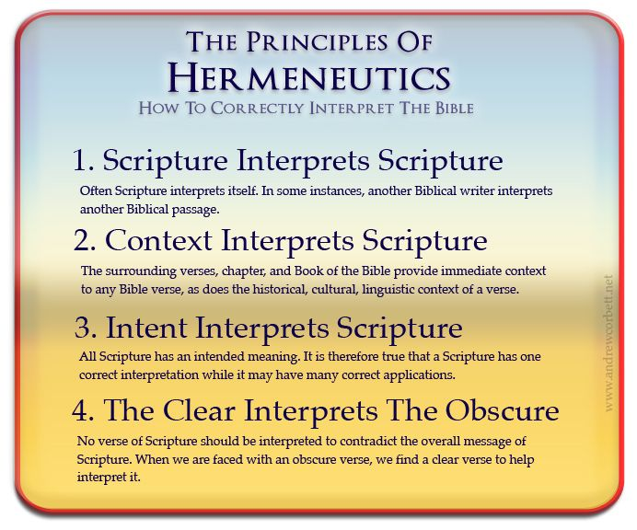
Historical-Cultural Context: Considers the customs, traditions, social settings, and historical events that influence the text.

Slide 3
14. Philemon | a.d. 60–62 | Paul
15. Acts | a.d. 62 | Luke
16. 1 Timothy | a.d. 62–64 | Paul
17. Titus | a.d. 62–64 | Paul
18. 1 Peter | a.d. 64–65 | Peter
19. 2 Timothy | a.d. 66–67 | Paul
20. 2 Peter | a.d. 67–68 | Peter
21. Hebrews | a.d. 67–69 | Unknown
22. Jude | a.d. 68–70 | Jude
23. John | a.d. 80–90 | John
24. 1 John | a.d. 90–95 | John
25. 2 John | a.d. 90–95 | John
26. 3 John | a.d. 90–95 | John
27. Revelation | a.d. 94–96 | John
Who?
When

Slide 4
Whom : To Titus
Greek
WWW
Uncircumcised
When : Date
AD 62-64
Where :
From Macedonia to Crete

Slide 5
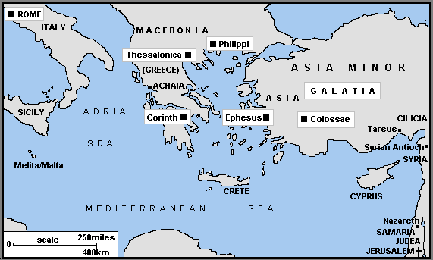
Crete
Notes:
http://www.ccel.org/bible/phillips/CNM12-AreaofActs.gif
Location of Nicopolis

Slide 6
WWW What must Titus do?
Godly leadership
  Appoint elders
  Rebuke false teachers
  Deal with the divisive
  Communicate the truth
  Model the truth
Silence Them
Avoid and Reject
Instruct God’s people
Sound faith & sound doctrine
These are Essentials for Effective Evangelism and Paul starts with leadership !
^{Tit 1:5} For this reason I left you in ª Crete, that you would set in order what remains and ^{b} appoint ^{c} elders in every city as I directed you,

Slide 7
Key themes (Power of the Gospel)
4)Communicate the truth ie Penalty of sin : Justification
5)Model the truth ie Power of sin : Sanctification
Tit 1:1 Paul, a bond-servant of God and an apostle of Jesus Christ,
for the faith of those chosen of God (Justification) and the knowledge of the truth which is according to godliness,(Sanctification )
Tit 1:2 in a the hope of eternal life (Glorification)., which God, who cannot lie, promised ,long ages ago,
Tit 2:11 For the grace of God has appeared, bringing salvation to all men, (Justification)
Tit 2:12 instructing us to deny ungodliness and worldly desires and to live sensibly, righteously and godly in the present age, (Sanctification)
Tit 2:13 looking for the blessed hope and the appearing of the glory of our great God and Savior, Christ Jesus, (Glorification)
Other scriptures on the Gospel (1:3–4; 2:10, 13; 3:4, 6).

Slide 8
QUALIFICATIONS OF ELDERS
• Blameless
• Husband of 1 wife
• Temperate
• Self controlled
• Respectable
• Sensible
• Gentle
• Upright
• Devout
• Hospitable
• Able to teach
• Free from the love of money
• Manage his own household well
• Children in submission
• Devoted to what is good
• Hold firm to the faith
• Good reputation among unbelievers
• Not prone to anger
• Not violent
• Not greedy for gain
• Not arrogant
• Not a drunkard
• Not contentious
• Not a recent convert
Older (presbuteros)
Overseer (episkopos)
Pastor (poimen)
Summary Four categories
Sexuality (one woman man)
Family leadership incl children
General character
Teach

Slide 9
Key themes (Power of the Gospel)
4)Model the truth ie Power of the Gospel : Sanctification
Elders must model the truth
1) word of God will not be dishonoured
2) that the name of God and his doctrine be not blasphemed.
3)so that he will be able both to exhort in sound doctrine and to refute those who contradict.
So

Slide 10
How is it modeled? Sound in Faith & Doctrine
Teaching of Sound (Hugiaino) Healthy doctrine 9 of 12 times in Tim/Titus
Tit 1:9 holding fast the faithful word which is in accordance with the teaching, so that he will be able both to exhort in sound doctrine and to refute those who contradict.
Tit 1:13 This testimony is true. For this reason reprove them severely so that they may be sound in the faith,
Tit 2:1 But as for you, speak the things which are fitting for sound doctrine.
Tit 2:2 Older men are to be temperate, dignified, sensible, sound in faith, in love, in perseverance.
2Tim 4:3 For ª the time will come when they will not endure ^{b} sound doctrine;

Slide 11
(We all called to model the truth ch2 )
We have all been called to holy living , older men , older woman , younger men ,younger woman, employees ..
Ch2 v5 ^{c} so that the word of God will not be dishonored.
V7 ..in all things show yourself to be ª an example of good deeds.
V8 ..so ª that the opponent will be put to shame, having nothing bad to say about us.

Slide 12
Questions
up to ch2v10

Slide 13
Titus 2:11-15
^{Tit 2:11} For the grace of God has appeared
Paul had instructed Titus on how to teach the various groups of people in the congregations at Crete (older men, older women, etc.). In verses 11-15, Paul brought them back to the gospel, which was the reason they should have served God. The gospel gave them the ability to serve him. In verse 11 Paul reminded the people of Crete that their lives had been filled with God’s grace. What did that grace “teach” them to do?
It taught them to say no to sin. It taught them to live upright lives in service to God.

Slide 14
Titus 3:1-2
What attitude should Christians have toward governments?
They will be subject to authorities, be ready to obey the laws, and do what is right. They will not slander their leaders. They will be peaceable and considerate toward their fellow citizens

Slide 15
Titus 3:1-8
Paul wants us to be careful to devote ourselves to doing what is good. How would this be accomplished among the people of Crete? How will it be accomplished in churches today?
Paul tells us what we are to stress so that people will live God-pleasing lives. Certainly instructions on what to do are important. Paul includes a lot of them in this letter. But the immediate context of Paul’s words is the gospel message he has just given us. He wants the gospel to be stressed. The gospel alone has made us God’s people. The gospel alone inspires us to live in service to God.

Slide 16
Titus 3:8
Why is serving the Lord in society ie doing good deeds “excellent and profitable” (verse 8)?
When the world sees God’s people doing the right things, God is glorified. The gospel is not maligned, and people are pointed to Christ

Slide 17
Titus 3:9
What are things Paul calls unprofitable and useless?
Foolish controversies, genealogies, arguments, and quarrels about the law.

Slide 18
Titus 3:10
Whats missing from this statement ?
We should only warn false teachers
Rejected warnings must lead to further action.
Tit 3:10 Reject a factious man after a first and second warning, (NASB)
Tit 3:10 As for a person who stirs up division, after warning him once and then twice, have nothing more to do with him,(ESV)
Rom 16:17 Now I urge you, brethren, keep your eye on those who cause dissensions and hindrances contrary to the teaching which you learned, and turn away from them.

Slide 19
Considerations
Know the truth
Speak the truth
Live the truth
This pattern leads to spiritual health
^{Jas 2:18 b}, and I will show you my faith by my works
Sound Faith & Sound doctrine leads to Good works
The faith we preach must be more than something we proclaim.
It must be something we live.
^{Mt 5:16} “Let your light shine before men in such a way that they may ª see your good works, and ^{b} glorify your Father who is in heaven

