Slide 1

Letters to Thessalonica

Slide 2
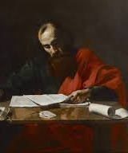
1 Thessalonians 1:1-10
1 Paul, Silvanus, and Timothy,
To the church of the Thessalonians in God the Father and the Lord Jesus Christ:
Grace to you and peace.
The Thessalonians' Faith and Example
² We give thanks to God always for all of you, constantly^{[a]} mentioning you in our prayers, ³ remembering before our God and Father your work of faith and labor of love and steadfastness of hope in our Lord Jesus Christ. ⁴ For we know, brothers^{[b]} loved by God, that he has chosen you, ⁵ because our gospel came to you not only in word, but also in power and in the Holy Spirit and with full conviction. You know what kind of men we proved to be among you for your sake. ⁶ And you became imitators of us and of the Lord, for you received the word in much affliction, with the joy of the Holy Spirit, ⁷ so that you became an example to all the believers in Macedonia and in Achaia. ⁸ For not only has the word of the Lord sounded forth from you in Macedonia and Achaia, but your faith in God has gone forth everywhere, so that we need not say anything. ⁹ For they themselves report concerning us the kind of reception we had among you, and how you turned to God from idols to serve the living and true God, ¹⁰ and to wait for his Son from heaven, whom he raised from the dead, Jesus who delivers us from the wrath to come.

Slide 3
“…for you received the word in much affliction…” (verse 6)
“…but your faith in God has gone forth everywhere…” (verse 8)
”…how you turned to God from idols…” (verse 9)
“…and to wait for his Son from heaven…” (verse 10)

Slide 4
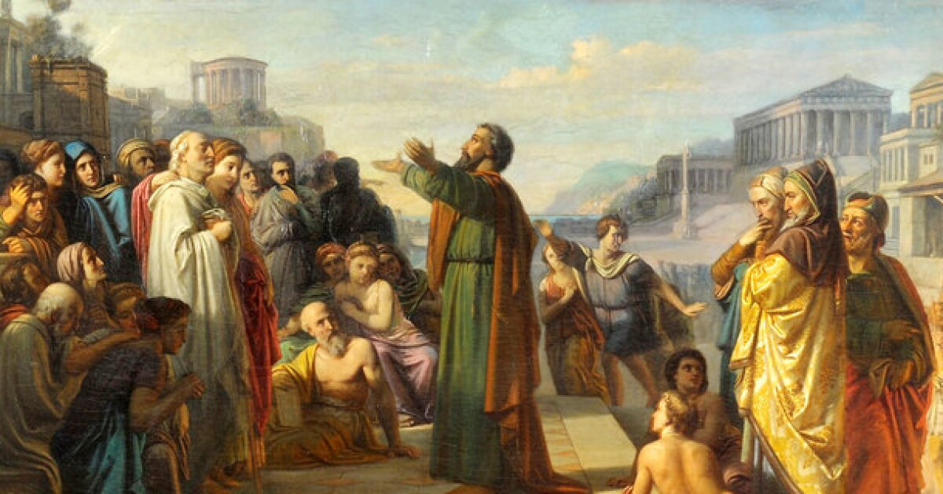
ACTS 17:1-9
Paul and Silas in Thessalonica
17 Now when they had passed through Amphipolis and Apollonia, they came to Thessalonica, where there was a synagogue of the Jews. ² And Paul went in, as was his custom, and on three Sabbath days he reasoned with them from the Scriptures, ³ explaining and proving that it was necessary for the Christ to suffer and to rise from the dead, and saying, “This Jesus, whom I proclaim to you, is the Christ.” ⁴ And some of them were persuaded and joined Paul and Silas, as did a great many of the devout Greeks and not a few of the leading women. ⁵ But the Jews^{[a]} were jealous, and taking some wicked men of the rabble, they formed a mob, set the city in an uproar, and attacked the house of Jason, seeking to bring them out to the crowd. ⁶ And when they could not find them, they dragged Jason and some of the brothers before the city authorities, shouting, “These men who have turned the world upside down have come here also, ⁷ and Jason has received them, and they are all acting against the decrees of Caesar, saying that there is another king, Jesus.” ⁸ And the people and the city authorities were disturbed when they heard these things. ⁹ And when they had taken money as security from Jason and the rest, they let them go.

Slide 5
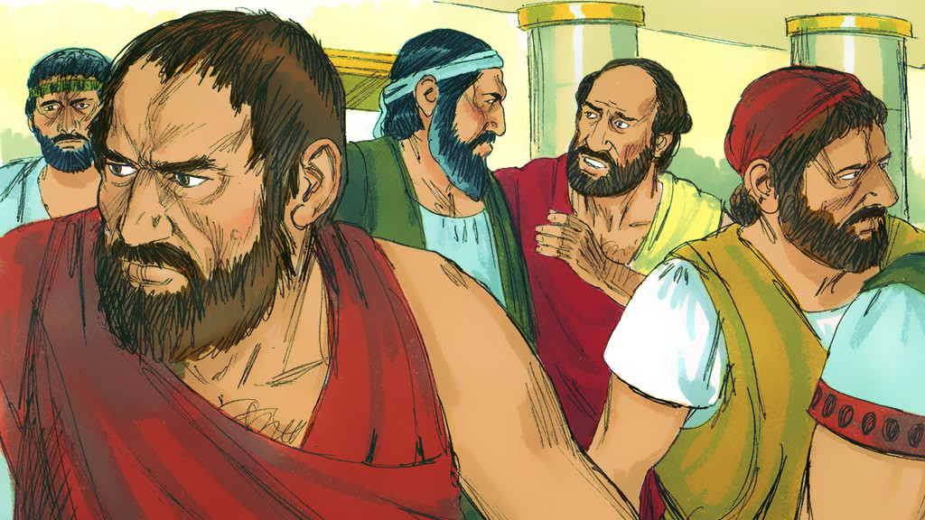
ACTS 17:10-15
Paul and Silas in Berea
¹⁰ The brothers^{[b]} immediately sent Paul and Silas away by night to Berea, and when they arrived they went into the Jewish synagogue. ¹¹ Now these Jews were more noble than those in Thessalonica; they received the word with all eagerness, examining the Scriptures daily to see if these things were so. ¹² Many of them therefore believed, with not a few Greek women of high standing as well as men. ¹³ But when the Jews from Thessalonica learned that the word of God was proclaimed by Paul at Berea also, they came there too, agitating and stirring up the crowds. ¹⁴ Then the brothers immediately sent Paul off on his way to the sea, but Silas and Timothy remained there. ¹⁵ Those who conducted Paul brought him as far as Athens, and after receiving a command for Silas and Timothy to come to him as soon as possible, they departed.

Slide 6
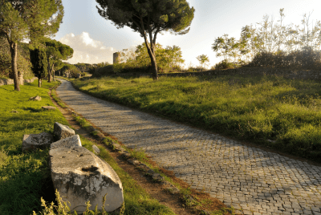
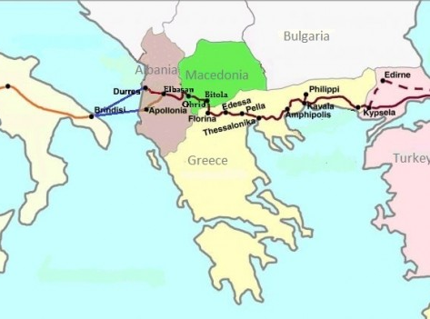
Via Egnatia

Slide 7
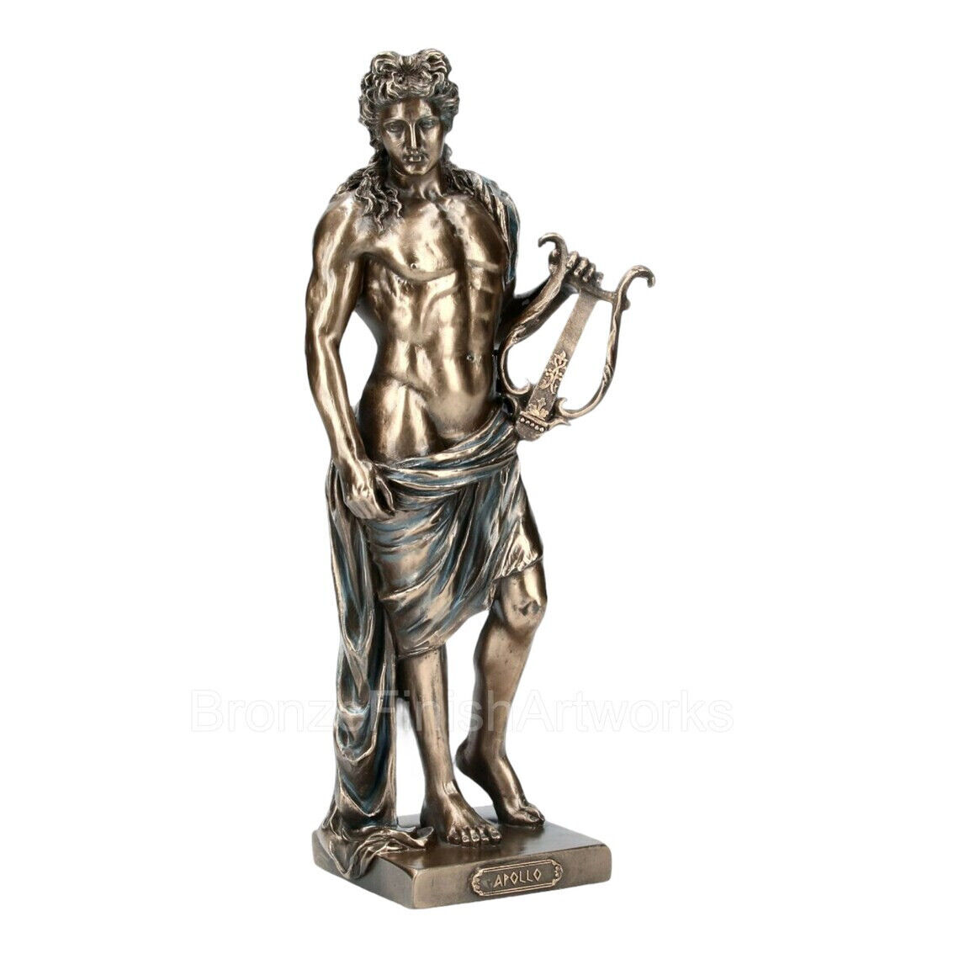
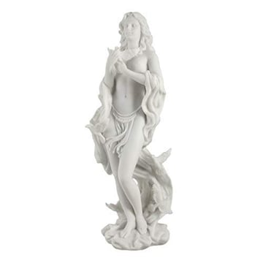
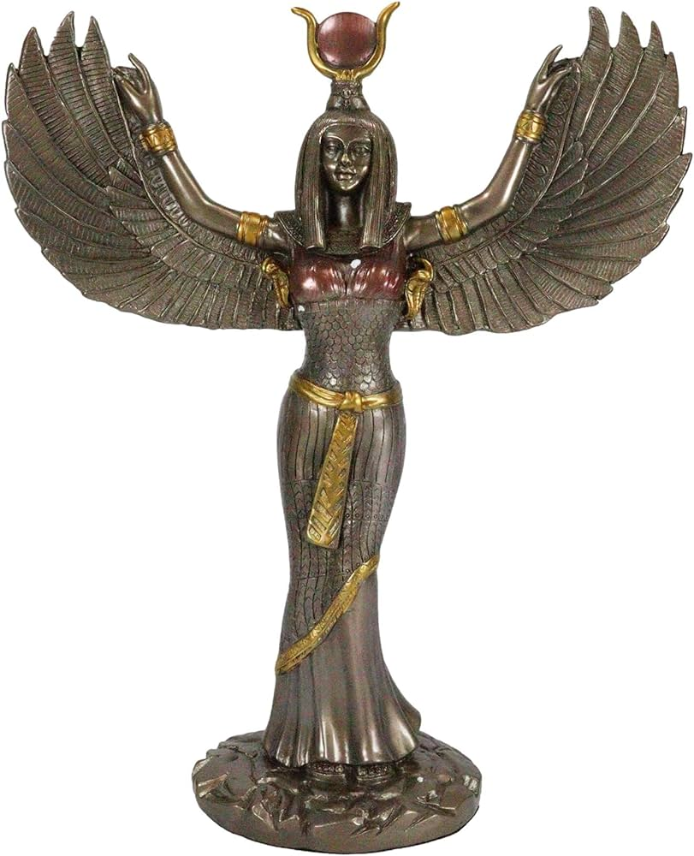
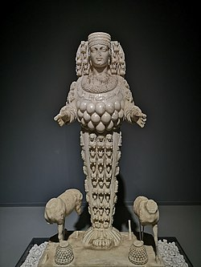
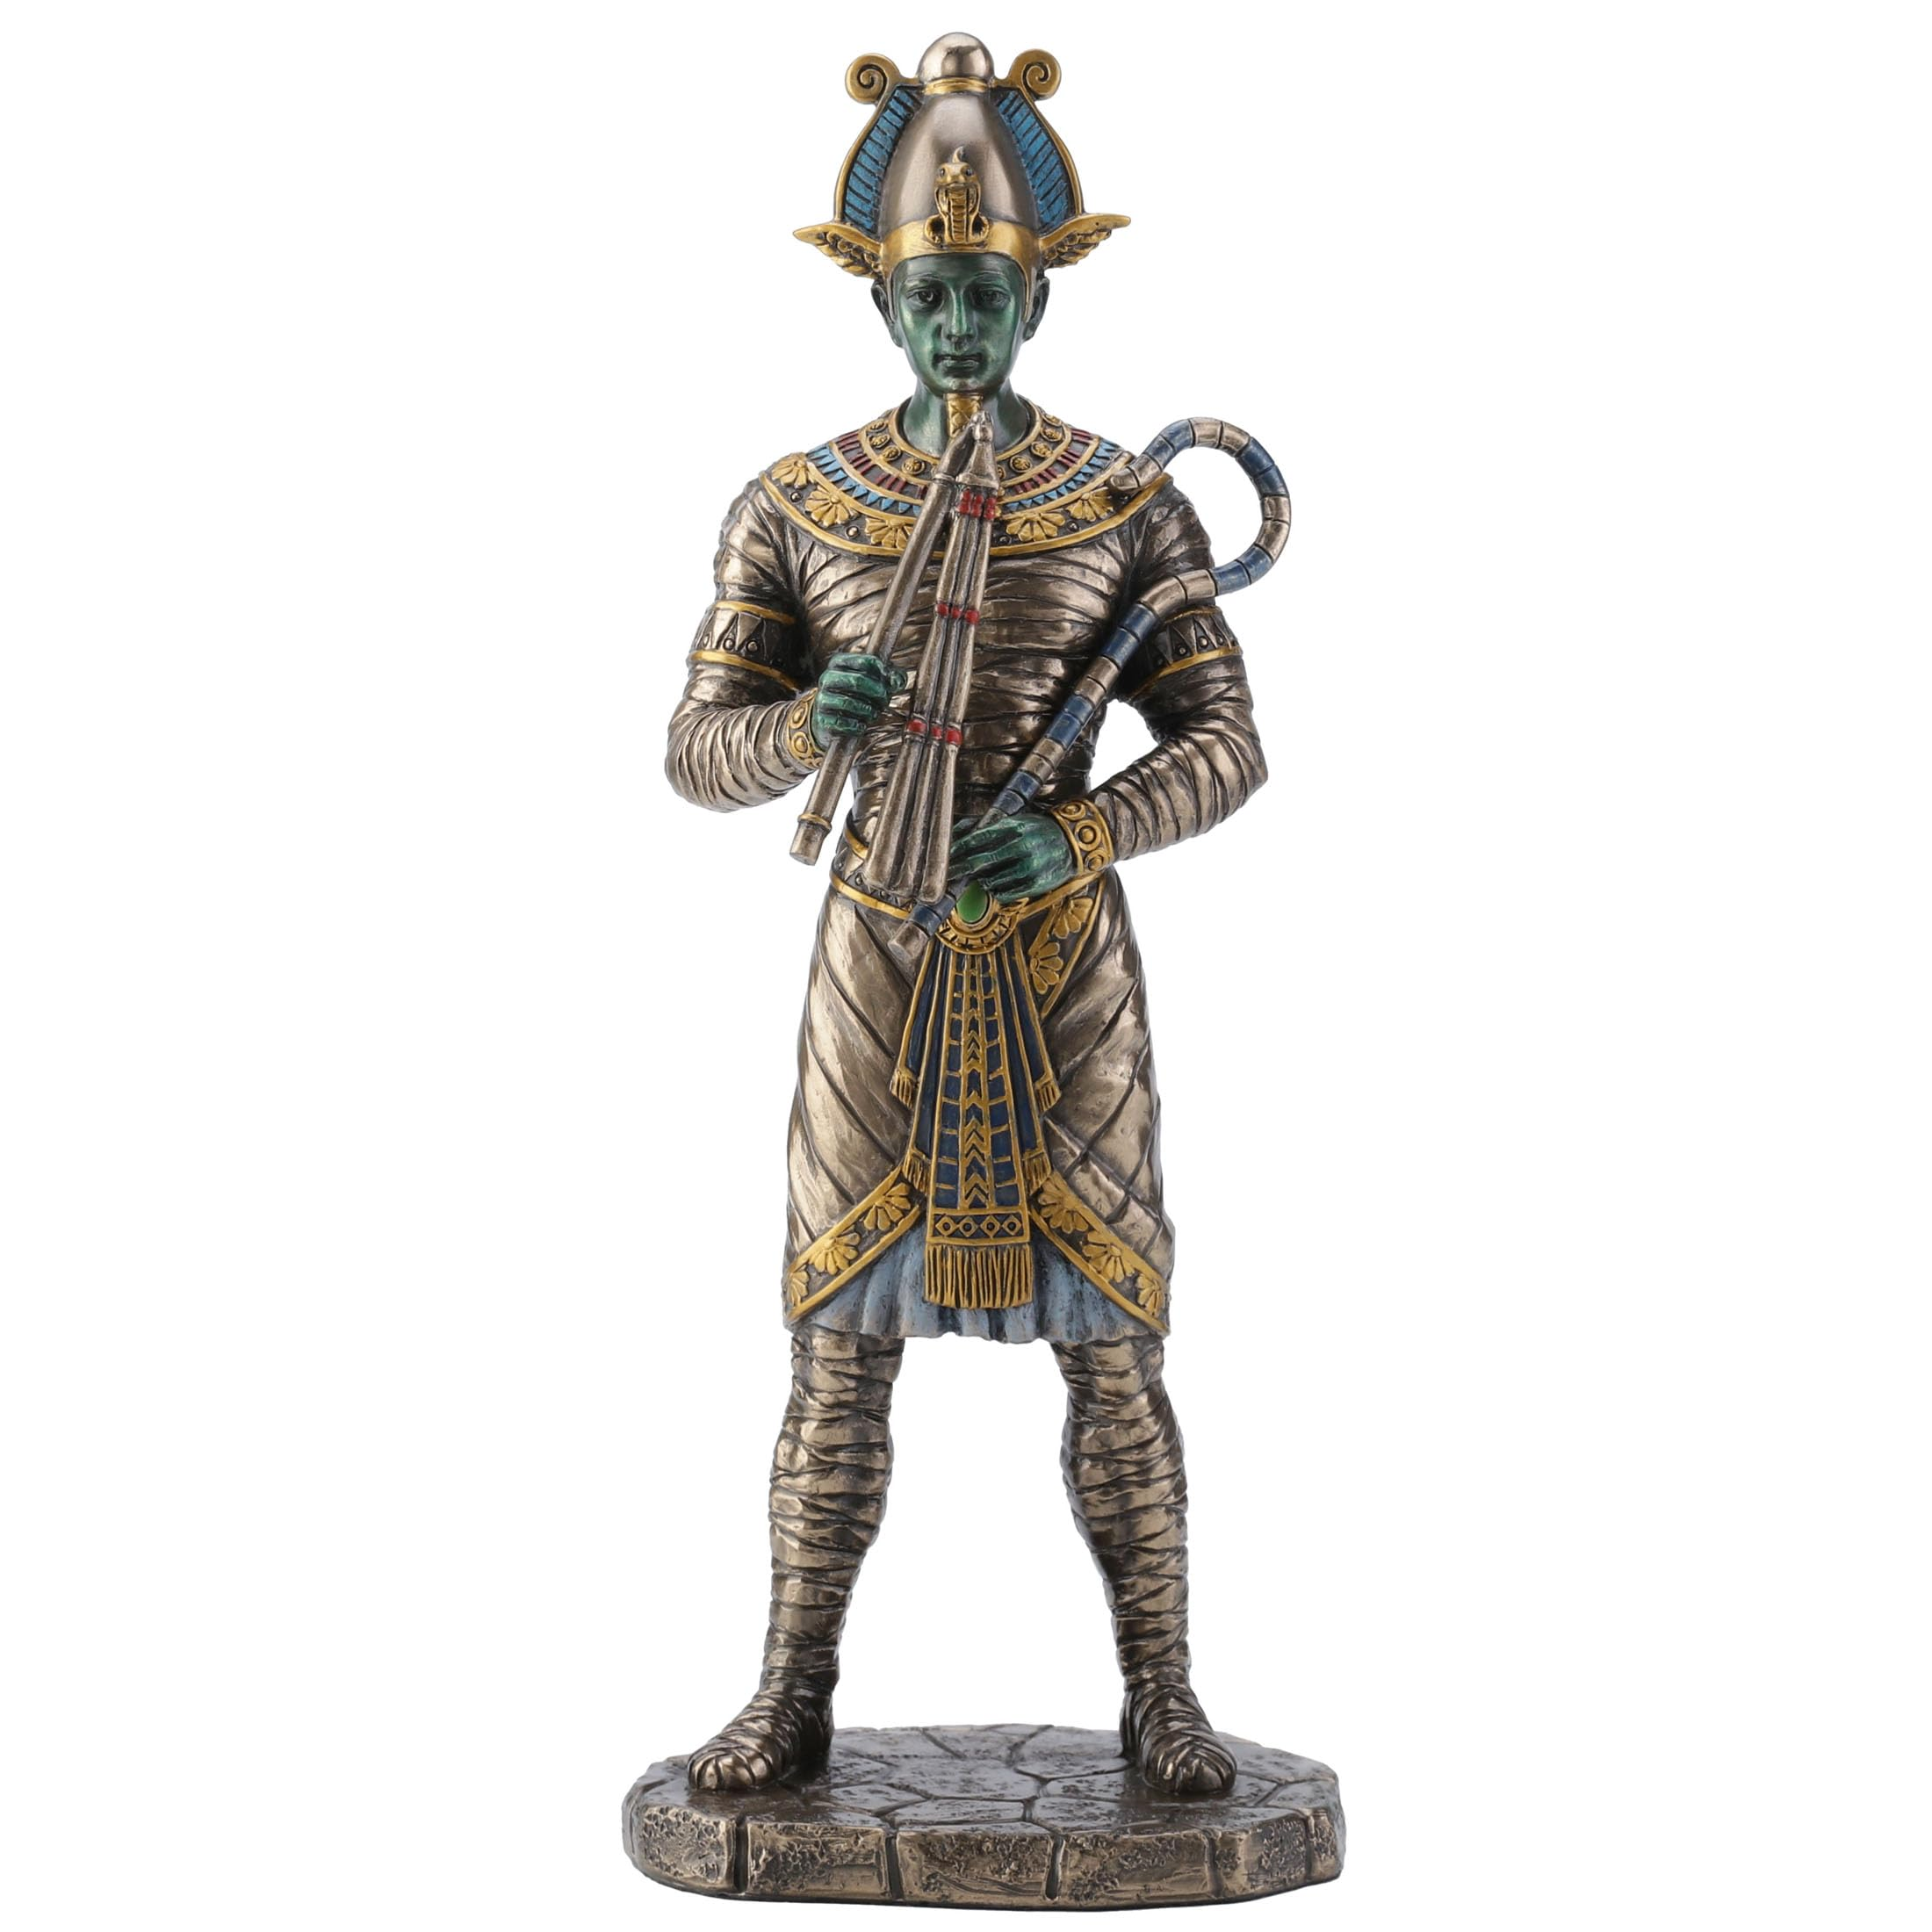
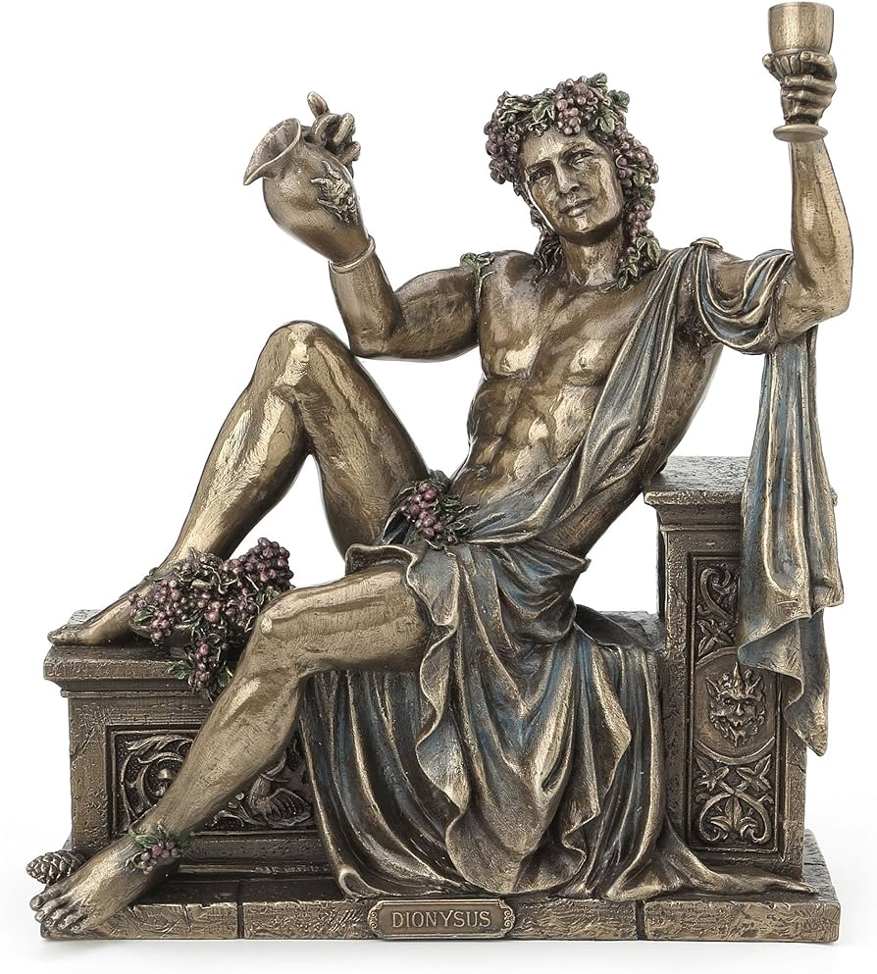
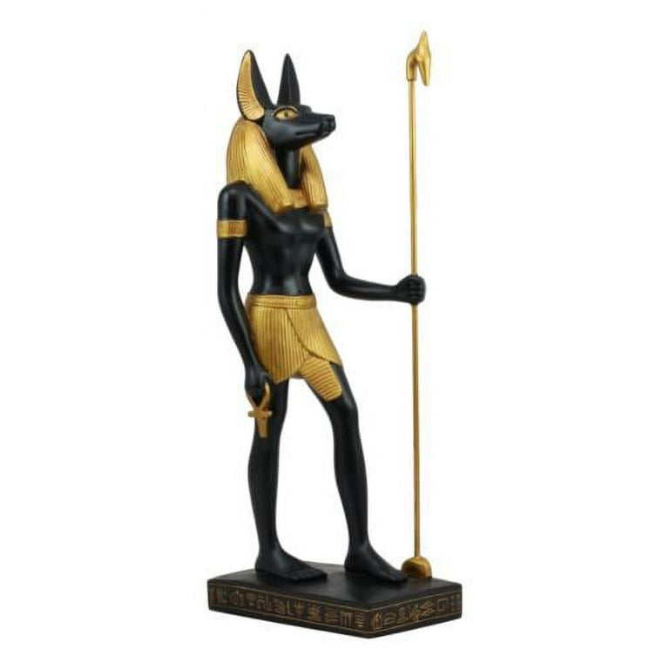
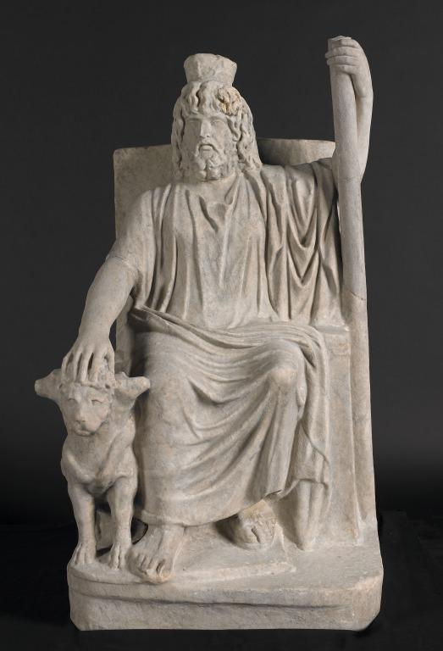
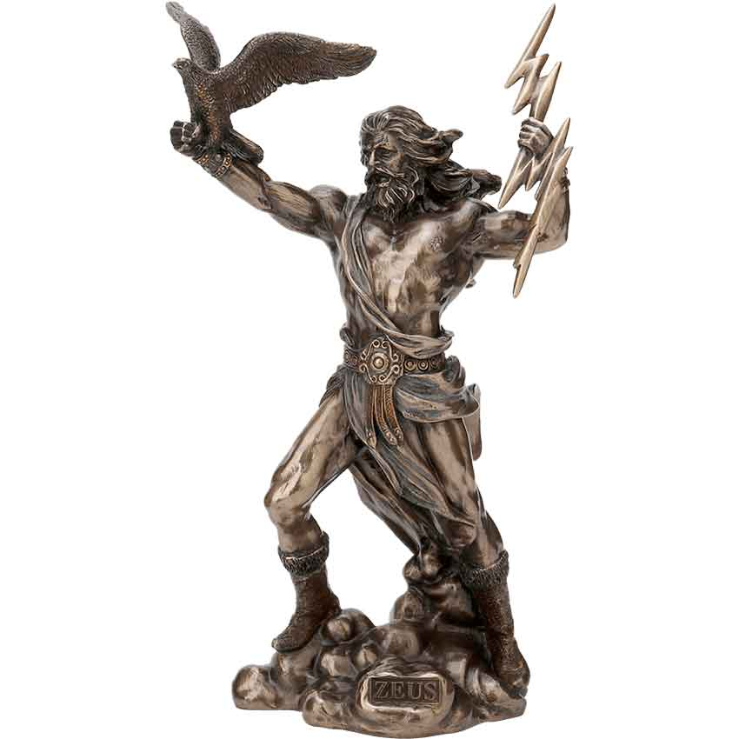
Apollo
Aphrodite
Isis
Artemis
Osiris
Dionysus
Serapis
Zeus
Anubis

Slide 8
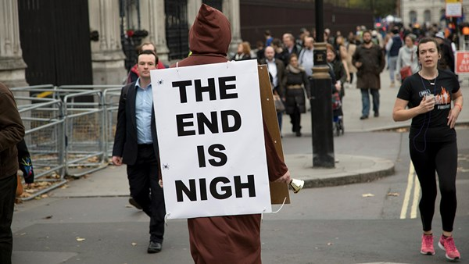

Slide 9
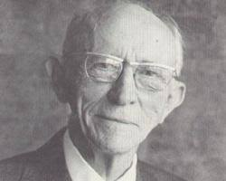
“Do not so contemplate eternity that you waste today.”
                Vance Havner

Slide 10
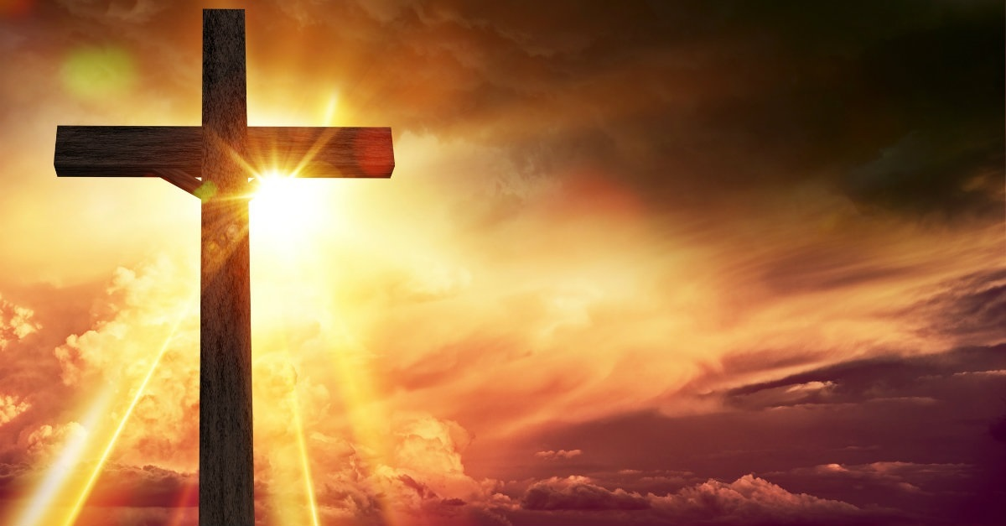
1 Peter 3:13-17
¹³ Now who is there to harm you if you are zealous for what is good?¹⁴ But even if you should suffer for righteousness' sake, you will be blessed. Have no fear of them, nor be troubled,¹⁵ but in your hearts honor Christ the Lord as holy, always being prepared to make a defense to anyone who asks you for a reason for the hope that is in you; yet do it with gentleness and respect,¹⁶ having a good conscience, so that, when you are slandered, those who revile your good behavior in Christ may be put to shame.¹⁷ For it is better to suffer for doing good, if that should be God's will, than for doing evil.

