Slide 1
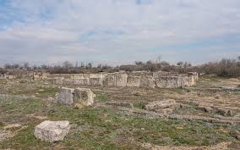
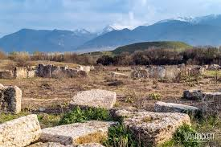
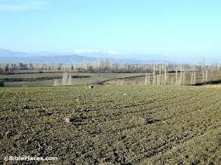
Colossians
Christ Centered

Slide 2
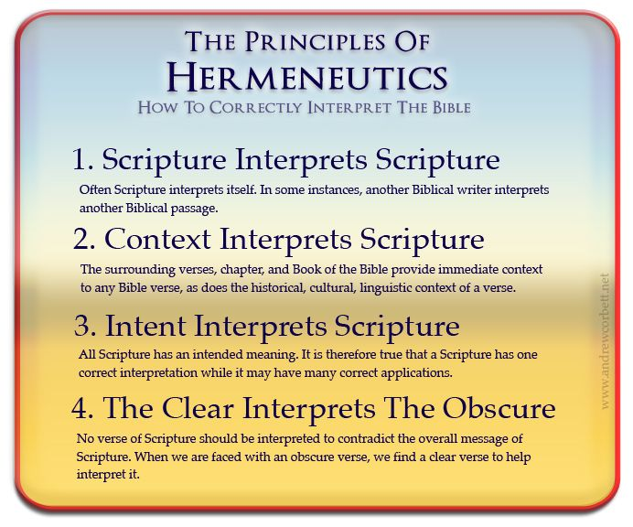

Slide 3
2Pet 1:20 But know this first of all, that no prophecy of Scripture is a matter of one’s own interpretation,
2Pet 1:21 for no prophecy was ever made by an act of human will, but men moved by the Holy Spirit spoke from God.
WWW
Who : Author
Paul
When : Date
AD 60-62
Where : From where to whom?
From prison in Rome to Colossae

Slide 4
The Progress of Revelation: New Testament
Book | Approximate Writing Date | Author
1. James | a.d. 45–49 | James
2. Galatians | a.d. 49–50 | Paul
3. Matthew | a.d. 50–60 | Matthew
4. Mark | a.d. 50–60 | Mark
5. 1 Thessalonians | a.d. 51 | Paul
6. 2 Thessalonians | a.d. 51–52 | Paul
7. 1 Corinthians | a.d. 55 | Paul
8. 2. Corinthians | a.d. 55–56 | Paul
9. Romans | a.d. 56 | Paul
10. Luke | a.d. 60–61 | Luke
11. Ephesians | a.d. 60–62 | Paul
12. Philippians | a.d. 60–62 | Paul
13. Colossians | a.d. 60–62 | Paul
When
Who?

Slide 5
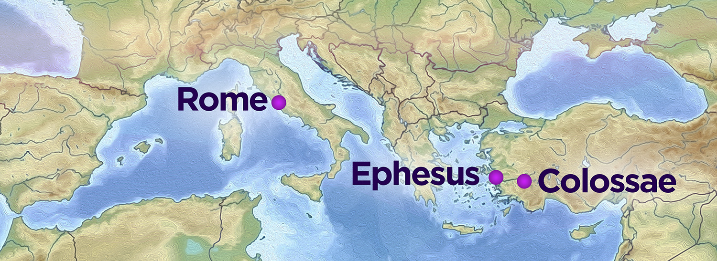
Who Del?
Delivered by Tychicus who was accompanied by Onesimus.
Where?
Who Est?
Col 1:7 just as you learned it from Epaphras, our beloved fellow bond-servant, who is a faithful servant of Christ on our behalf,

Slide 6
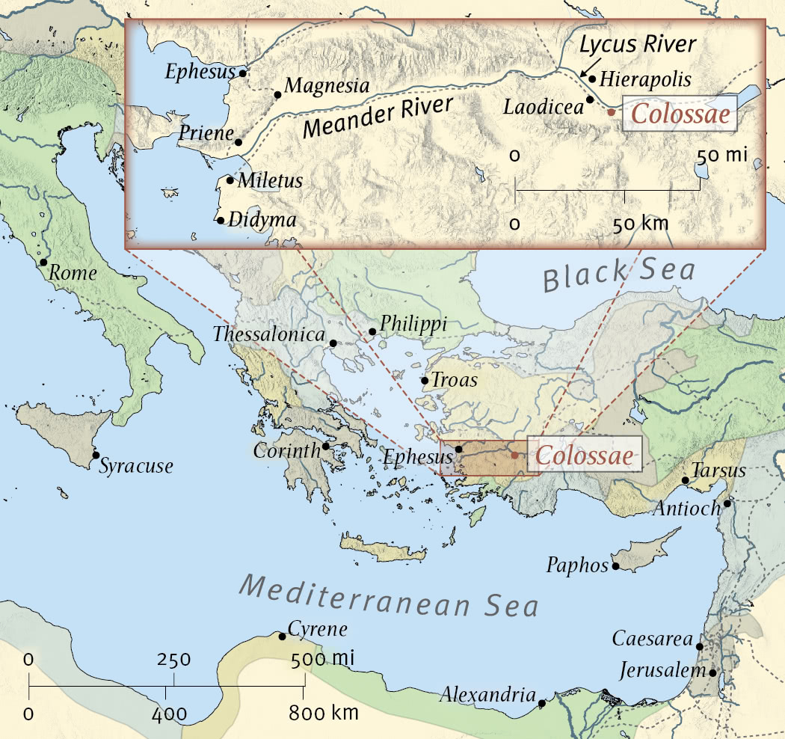
Col 4:16 When this letter is read among you,
have it also read in the church of the Laodiceans;

Slide 7
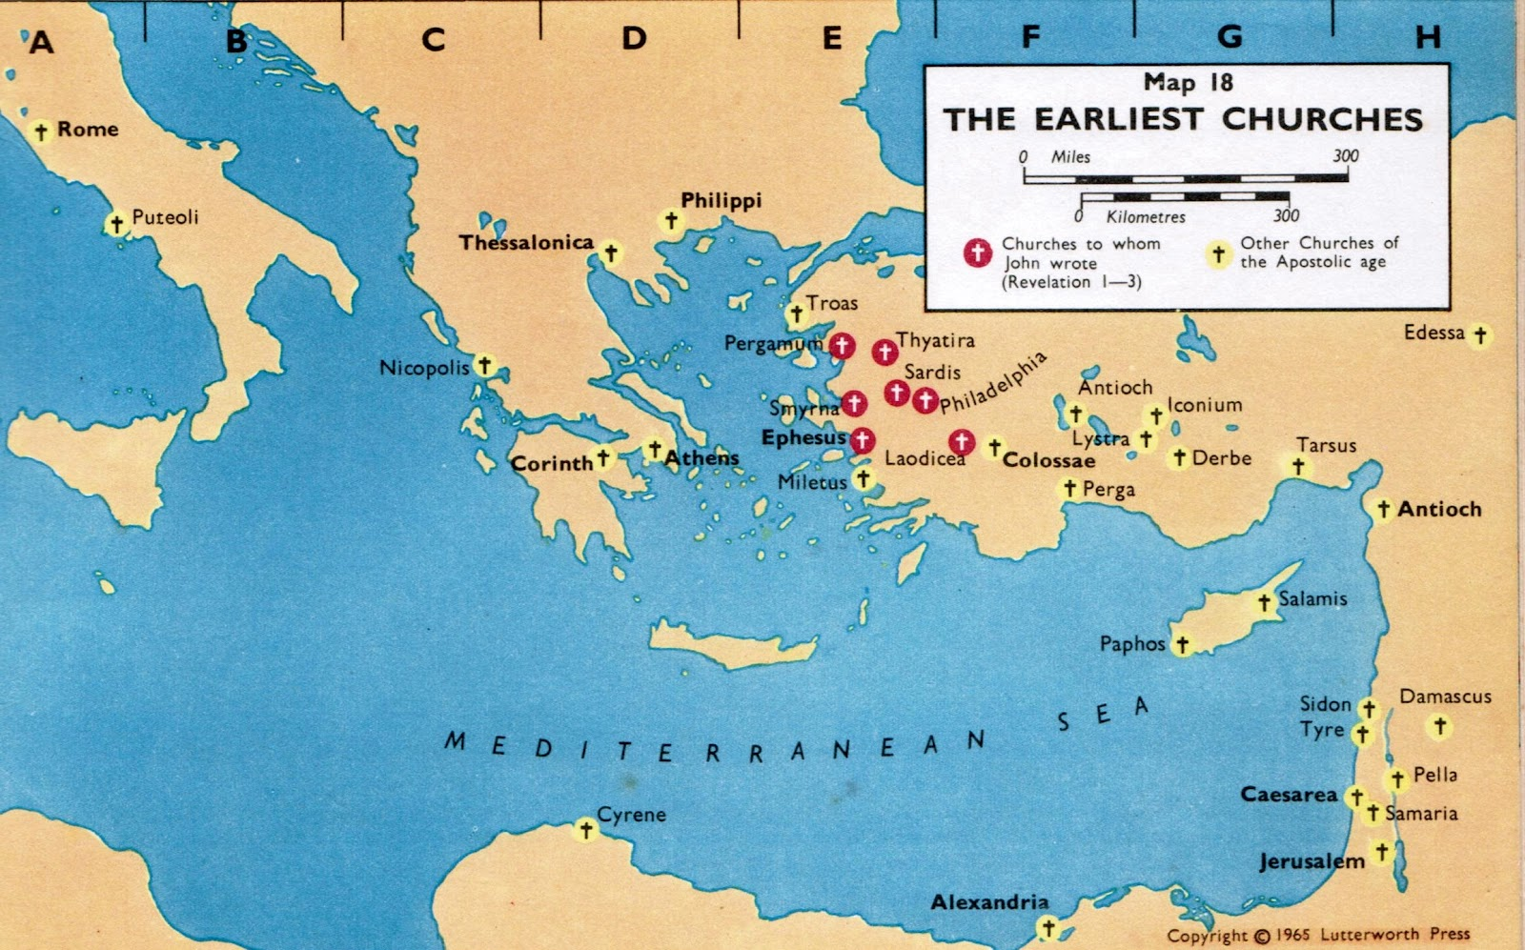
Colossae and Laodicea were strategically situated along several major trade routes, including the Royal Road that connected Ephesus to the Euphrates River
Colossae & Laodicea : Pluralistic towns (not one faith) variety of cultural backgrounds & beliefs

Slide 8
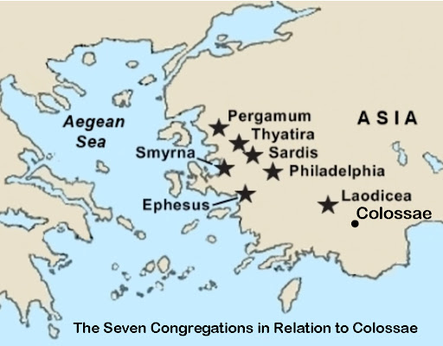
Rev 3:17 ‘Because you say, “I am rich, and have become wealthy, and have need of nothing,” and you do not know that you are wretched and miserable and poor and blind and naked,

Slide 9
Key Verses
Col 1:13 For He rescued us from the domain of darkness, and transferred us to the kingdom of His beloved Son,
Col 1:19 For it was the Father’s good pleasure for all the fullness to dwell in Him,
Col 1:20 and through Him to reconcile all things to Himself, having made peace through the blood of His cross; through Him, I say, whether things on earth or things in heaven.
Col 2:3 in whom are hidden all the treasures of wisdom and knowledge.
Col 2:6 Therefore as you have received Christ Jesus the Lord, so walk in Him,
Col 2:7 having been firmly rooted and now being built up in Him and established in your faith, just as you were instructed, and overflowing with gratitude.
Col 2:8 See to it that no one takes you captive through philosophy and empty deception, according to the tradition of men, according to the elementary principles of the world, rather than according to Christ.
Col 2:9 For in Him all the fullness of Deity dwells in bodily form,
Col 2:10 and in Him you have been made complete, and He is the head over all rule and authority;
Col 2:13 When you were dead in your transgressions and the uncircumcision of your flesh, He made you alive together with Him, having forgiven us all our transgressions,
Col 3:1 Therefore if you have been raised up with Christ, keep seeking the things above, where Christ is, seated at the right hand of God.
Col 3:5 Therefore consider the members of your earthly body as dead to immorality, impurity, passion, evil desire, and greed, which amounts to idolatry.
Col 3:12 So, as those who have been chosen of God, holy and beloved, put on a heart of compassion, kindness, humility, gentleness and patience;
Col 3:13 bearing with one another, and forgiving each other, whoever has a complaint against anyone; just as the Lord forgave you, so also should you.
Col 4:6 Let your speech always be with grace, as though seasoned with salt, so that you will know how you should respond to each person.

Slide 10
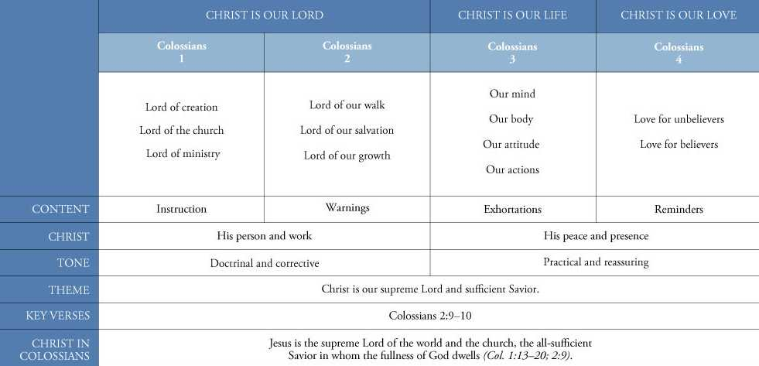
Supremacy and Sufficiency of Christ
Deity of Christ
Col 2:9 For in Him all the fullness of Deity dwells in bodily form,
Col 2:10 and in Him you have been made complete, and He is the head over all rule and authority;
Therefore Christ is enough !

Slide 11
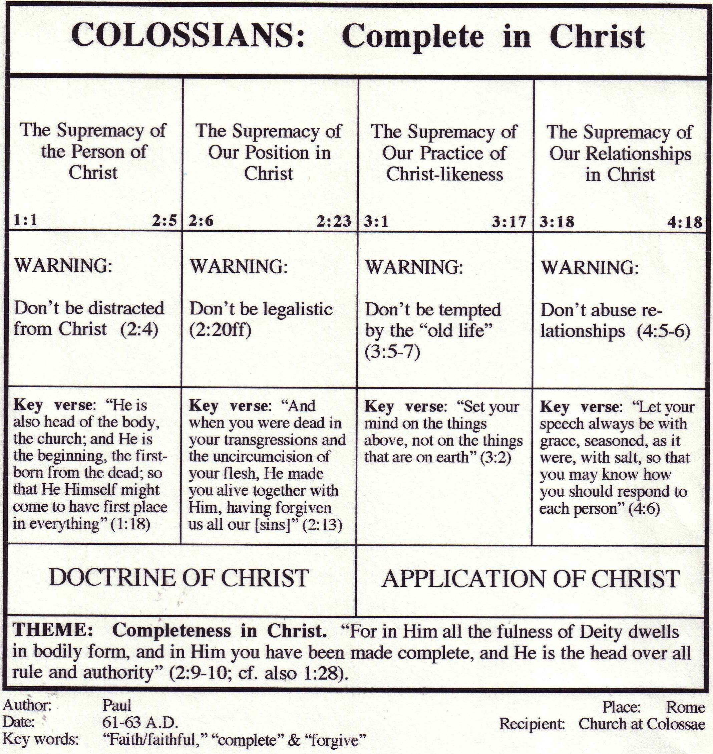
Christ referred to 25x
alluded to 65x
all x30
Christ’s Supremacy Displayed
Christ’s Supremacy Defended
Christ’s Supremacy Demanded
Christ’s Supremacy Outworked

Slide 12
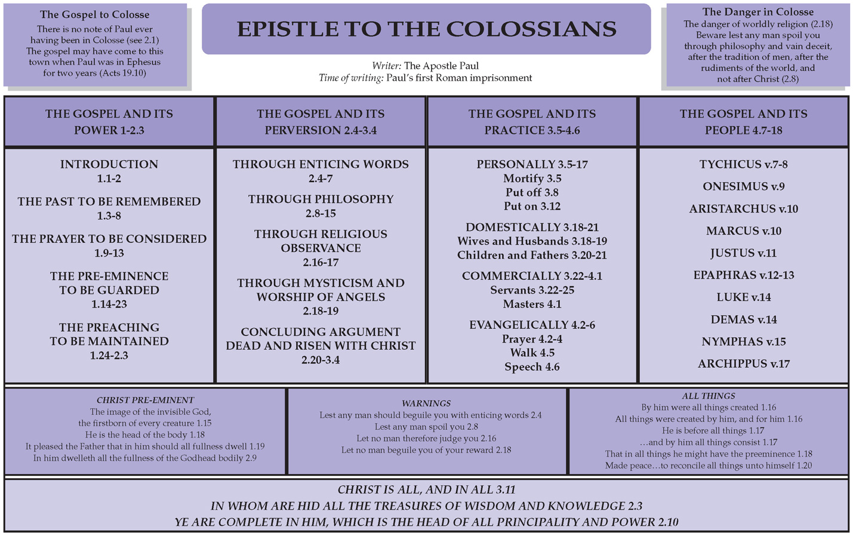
Col 2:6 ..so walk in Him,
Col 2:7 ..Rooted & built up in Him
Col 1:28 …., so that we may present every man complete in Christ.

Slide 13




To be a Christian is to realize that our entire existence is due to Christ and respond in such a way that this knowledge affects every aspect of our lives.
And in all
Col 3 v11

Slide 14
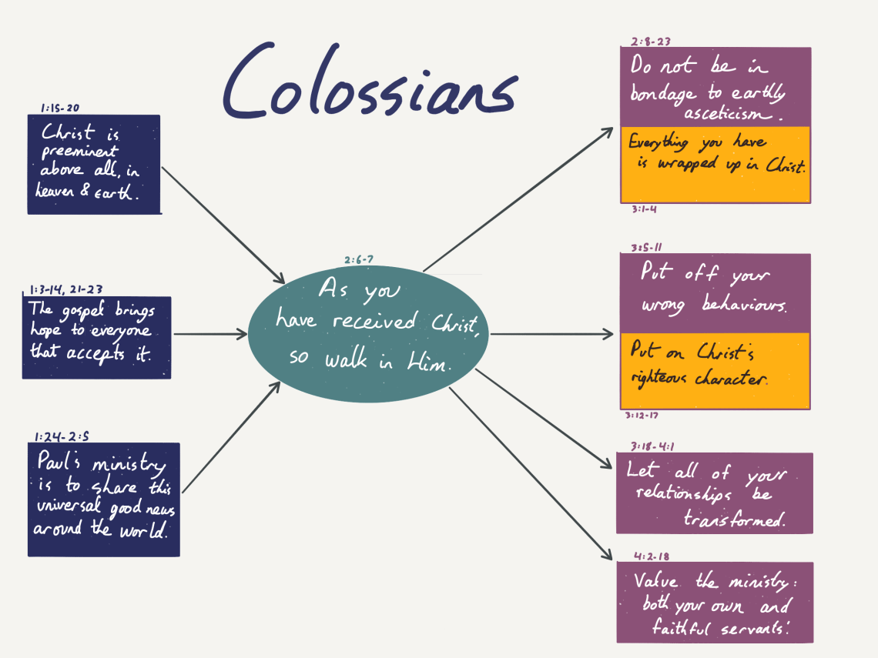
Be far sighted
Be pure
PUT OFF (Died)
Be considerate
Be loving
Be thankful
Be Christ controlled
Be compassionate
PUT ON (Raised col3 v1)
Be submissive
Be interrelated
Be obedient
Be wise

Slide 15
Eph 5:18 And do not get drunk with wine, for that is dissipation, but be filled with the Spirit,
Col 3:16 Let the word of Christ richly dwell within you,
  What does it look like to put on Christ? , filled by the spirit? , sow into the eternal?
Eph 5:19 speaking to one another in psalms and hymns and spiritual songs, singing and making melody with your heart to the Lord;
Eph 5:20 always giving thanks for all things in the name of our Lord Jesus Christ to God, even the Father;
Col 3:17 Whatever you do in word or deed, do all in the name of the Lord Jesus, giving thanks through Him to God the Father.
Eph 5:21 and be subject to one another in the fear of Christ.
Eph 5:22 Wives, be subject to your own husbands, as to the Lord.
Col 3:18 Wives, be subject to your husbands, as is fitting in the Lord.
Eph 5:23-28 Husbands love your wives
…. Children ,slaves , masters
Col 3:19 Husbands, love your wives and do not be embittered against them.
… Children , slaves , masters
Ephesians
Scripture interprets scripture

Slide 16
Summary
We should be Christ more not Christ less
In Jesus you have already experienced all God’s fullness.”
Jesus is all you need, live in union with him .
Colossians teaches us that we are complete in Christ, lacking nothing. Our identity and worth are found in Him alone." - Warren W. Wiersbe
We must put on the virtues of the new humanity being formed in Christ.”

Slide 17
Christ is not only the one who created all things but also the one in whom all things hold together." - Timothy Keller
The key to understanding Colossians is recognizing the supremacy and sufficiency of Christ in all aspects of the believer's life and salvation. Any attempt to diminish Christ's preeminence leads to theological error and spiritual danger.“Charles Hodge
The key theme of Colossians is the fullness and sufficiency of Christ. This emphasis challenges believers to live out their faith in Christ with confidence and assurance, knowing that they lack nothing in Him." James Dunn
Paul's letter to the Colossians serves as a powerful reminder that all believers are united with Christ in his death and resurrection, and as such, they are complete and lacking nothing in Him.“ Charles Hodge

Slide 18
Considerations
Col3 v11 Christ is all, and in all. Are you living that ?
Live in the present as who you already are in Christ
Do you say I believe in the supremacy and sufficiency of Christ but deny the reality of that in your life?
Is Jesus enough? or do you feel you need to fill your life with other things?
How much time is spend with Jesus?
Are other things dominating your life ?
Loved ones , sport , nature , social media?

Slide 19
Questions and Answers

